Slide 1


Slide 2
Heat transfer enhancement in a pipe filled with metal foam
By: Raad Mohammed Kathem
Supervised by :
Assist. Prof. Dr. Sajida Lafta

Slide 3
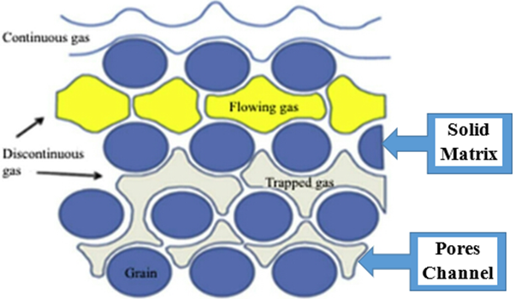
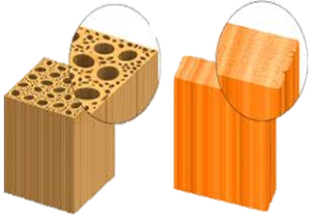
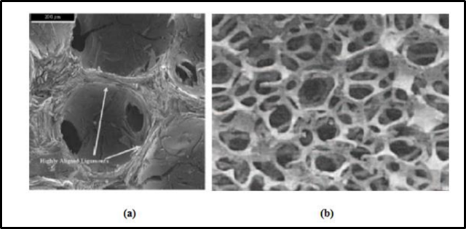
What Is Porous Media?
Porous media denote a system include a rigid matrix with connected void
Fluid through voids may be single-phase flow or two-phase flow
Literature
Conclusions
Modeling
Introduction
Recommendations
The sources Porous media can be:
Nature, brick, limestone, rye bread, human lunged.
Man-made (macroscopic packed spheres or column ,stacks of fissures and wood).
Metal foam

Slide 4
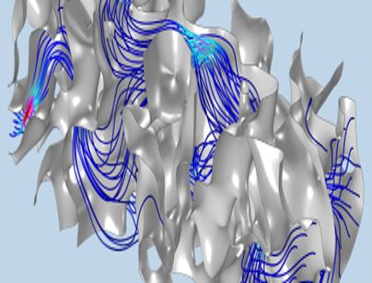
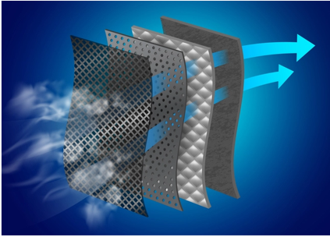
What Is Porous Media?
While metal foam has a high thermal conductivity, it raises the stationary thermal conductivity of the flow field.
Metal foam increases the area of heat transfer between solid and fluid phases significantly.
Fluid is mixed with an additional thermal conductive in the cell of metal foam.
Recommendations
Introduction

Slide 5
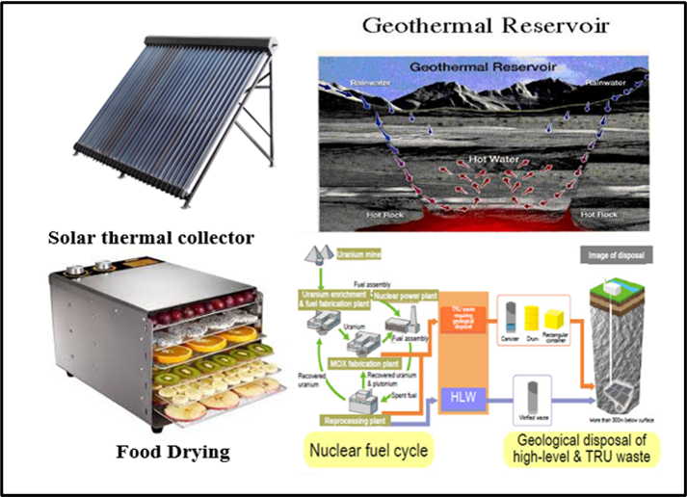
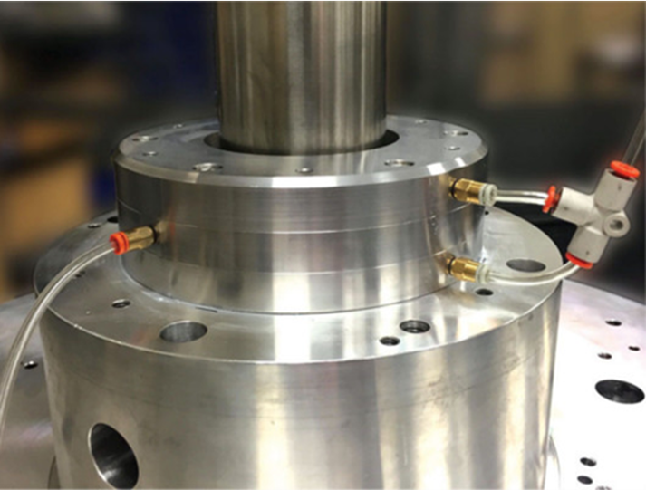


Applications
The porous media enhances the heat transfer in different energy type like renewable power (geothermal, Wind and solar) and increase efficiency of heat exchanger with other applications.
Result
Literature
Introduction
Conclusions
Modeling
Recommendations
Chemical engineering: storage and drying of fruit and grain, underground radioactive waste, etc.
Mechanical engineering : Fibrous and granular thermal insulation for pipeline and equipment’s, cooling of nuclear fuel debris , Lubrication of synovial joints in human body such hip and knee and gas bearing.

Slide 6

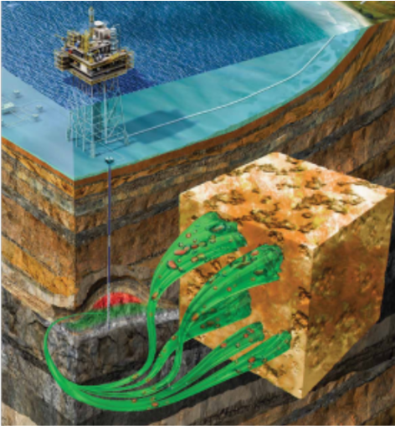

Applications
Automotive industrial machines like as the door sill was filled with metal foam to increase the stiffness and reinforce, electric car segment, train support
Result
Literature
Heat exchanger, Bio-medical applications
Conclusions
Modeling
Introduction
Recommendations

Slide 7




Literature Review
The review of previous studies on convection heat transfer from 2000 to 2021.
The number of surveyed is about (45) which display in three sections:
A section of the research dealt with the theoretical side and the
other section dealt with the practical side
Also, some of them used a heat exchanger, pipe , duct or two plates, and they were partially or completely filled with metal foam.
Result
Literature
Review
Conclusions
Modeling
Recommendations
Introduction
They are Notes the effect of different parameters such as porosity, pore density, the thickness of metal foam, GMF GPM , constant heat flux, constant wall temperature, and change in the geometry of the pipe.
Part of the research also be local thermal equilibrium and local thermal nonequilibrium
Most of the research investigated the pipe with metal foam numerically

Slide 8
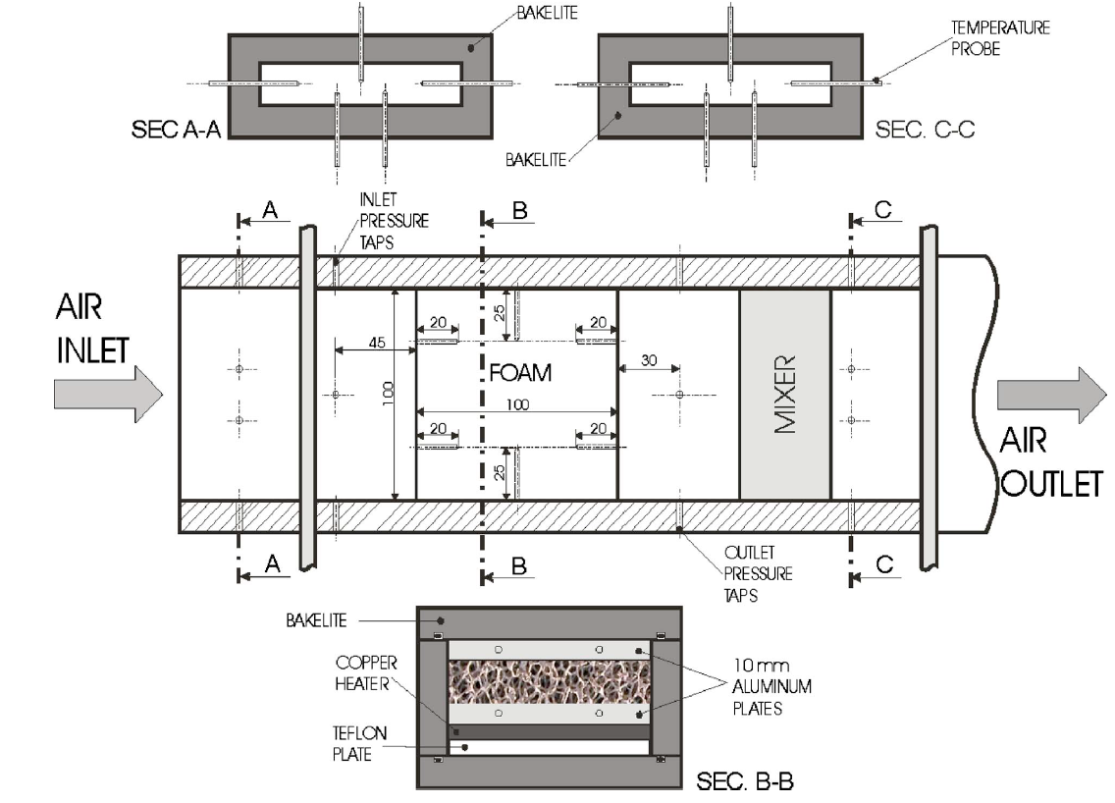
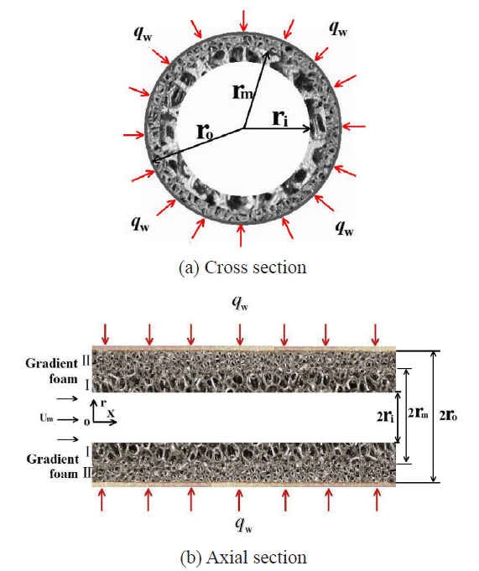
(Mancin et al. 2011,2012) studies the effect of the thickness of metal foam on heat transfer enhancement.
(Z.G. Xu et al. 2018) uses Gradient metal foams (GMFs) with different value of pore density (PPI) to study fully developed forced convective heat transfer in tubes filled partially with metal foam.
(Hamdi E. Ahmed et al. 2019) uses helical grooves

Slide 9
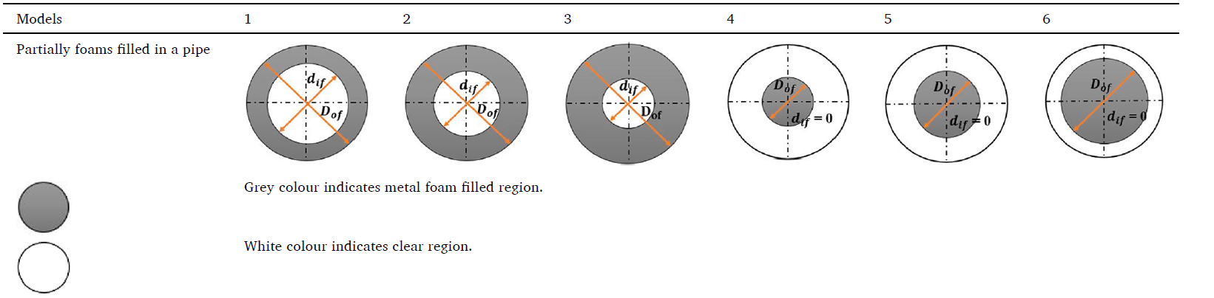
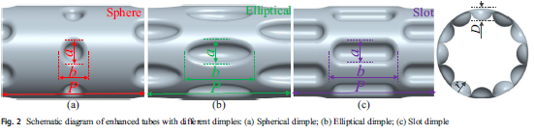
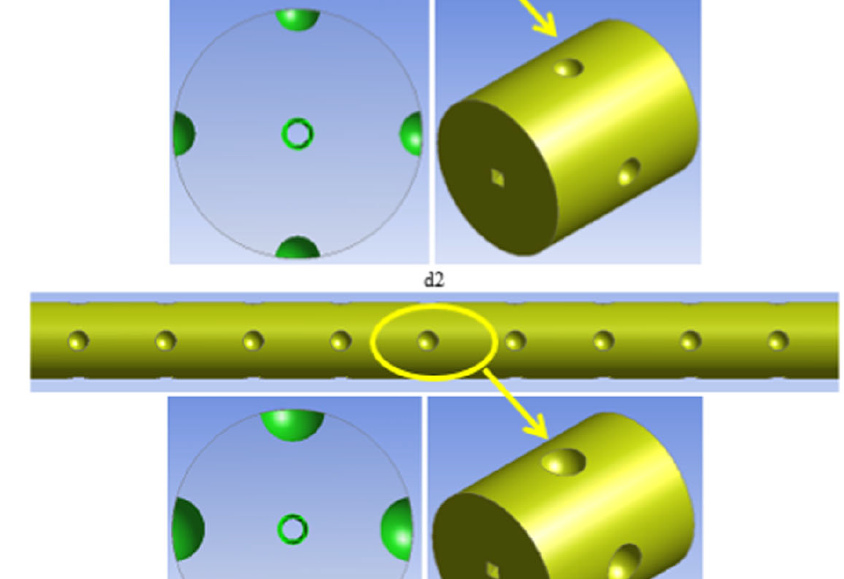
(Prakash H. Jadhav et al. 2021, 2020) studied the influence thickness of metal from the center of the pipe to the wall with different values of (PPI)(10-45) and porosity (0.9-0.95).
(Liang Zhang et al. 2019) studied the influence of dimples on the surface of the pipe.

Slide 10
Validation
a) 10PPI, Re=1125
b) 10PPI, Re=3500
(a) 10PPI
(b) 45PPI
Figure (2) Comparison the results of a pipe partially filled with metal foam (10,45) PPI and the results of Prakash H. Jadhav in 2021.
c) 40PPI, Re=1125
d) 40PPI, Re=3500
Figure (1): Comparison of Numerical result of wall temperature between present study for the pipe filled with metal foam (10,40) PPI with prakash H.Jadhav et al. 2020.

Slide 11
Objectives & Plan of The Work
The aim of this research is to study numerically and experimentally the heat transfer enhancement inside a pipe subjected to constant heat flux filled partially or completely with metal foam and compared the result between them
Result
Literature
Conclusions
Modeling
Introduction
Recommendations
The force convection heat transfer in a pipe with different cases was investigated

Slide 12
Scope of Present Work:
Four parameter will be investigated
Thickness
Geometry
Heat
Flux
(″q)
Pore density
l
M0deling
Literature Review
Conclusions
Literature
Introduction
Recommendations
Modeling
Experimental Work using different Test section
Numerical Simulation using Ansys Program
Compare the Experimental work with the Numerical simulation to verify the results

Slide 13
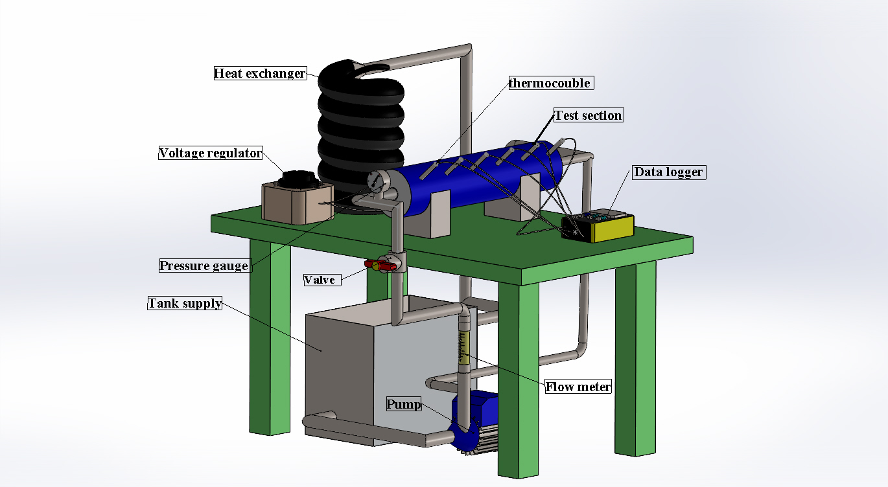

Slide 14
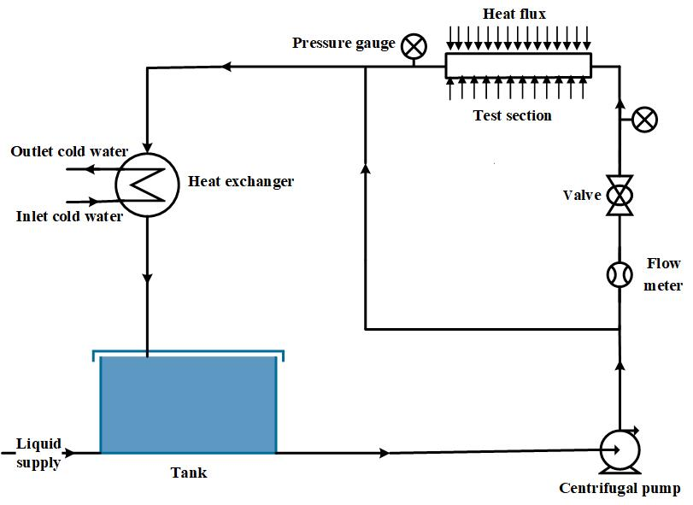
Scope of Present Work:
Experimental work
Literature
Modeling
Introduction

Slide 15
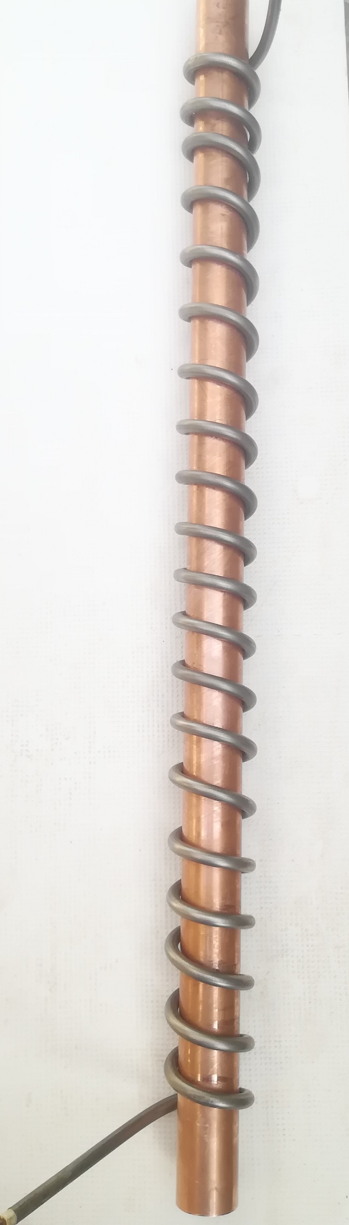
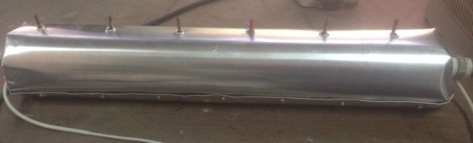
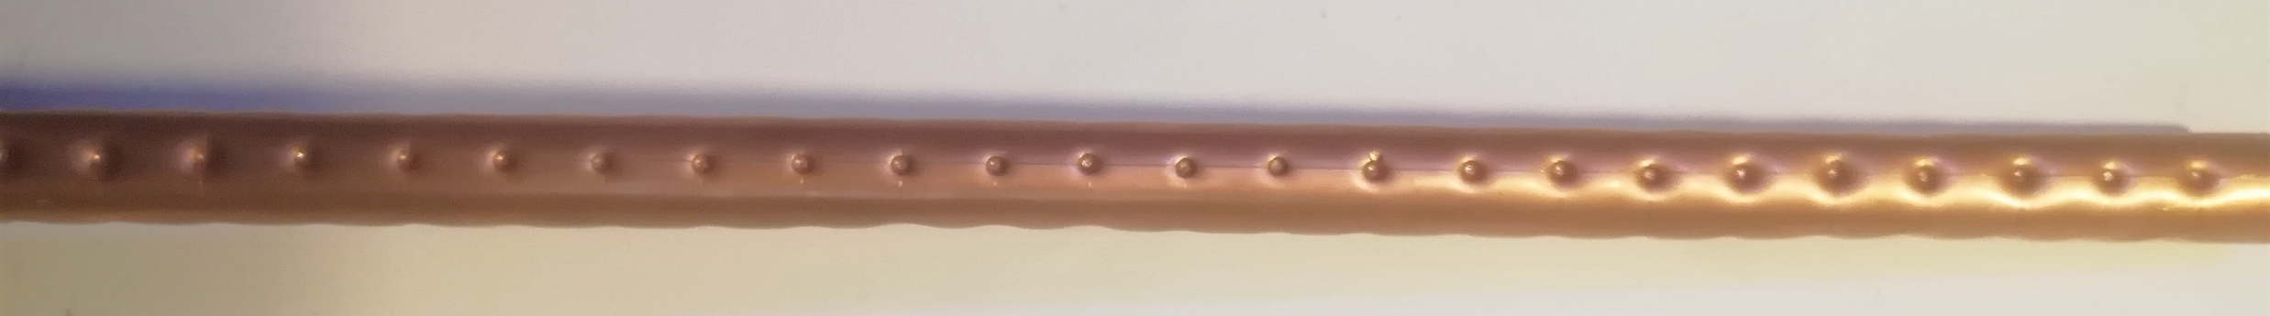
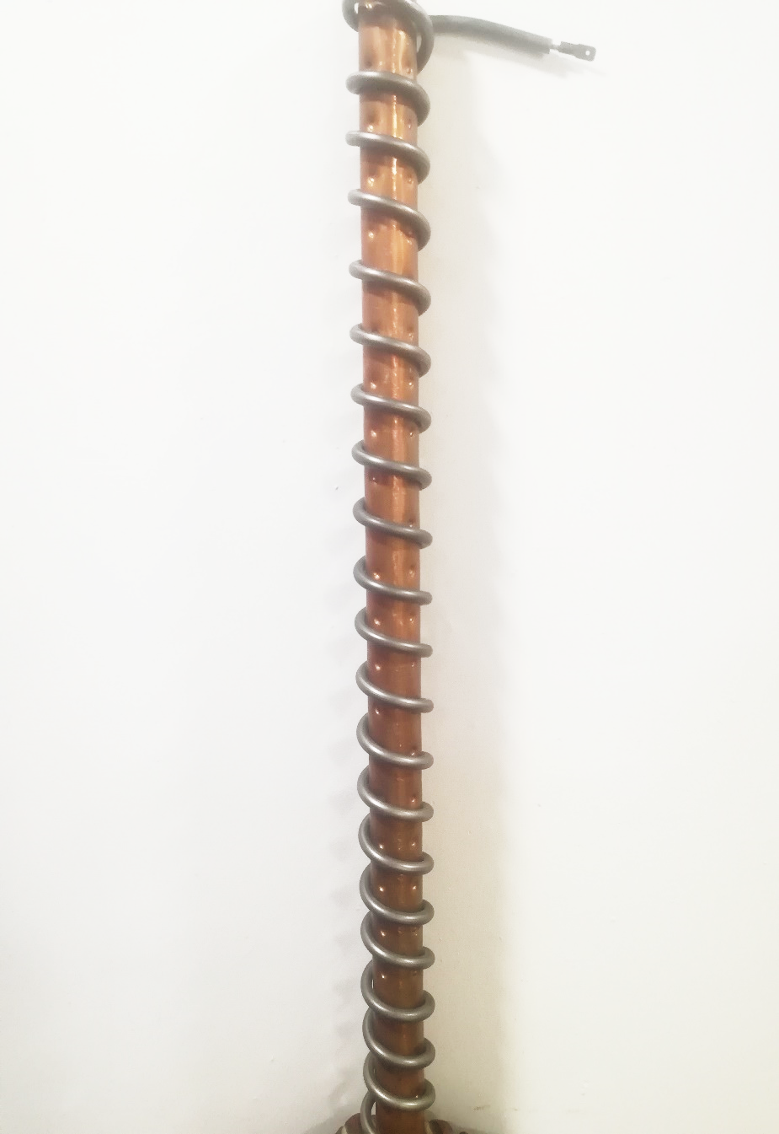
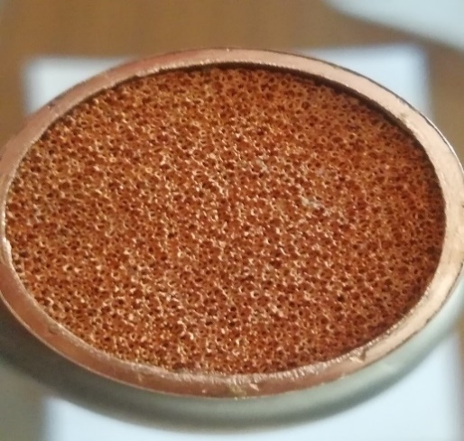
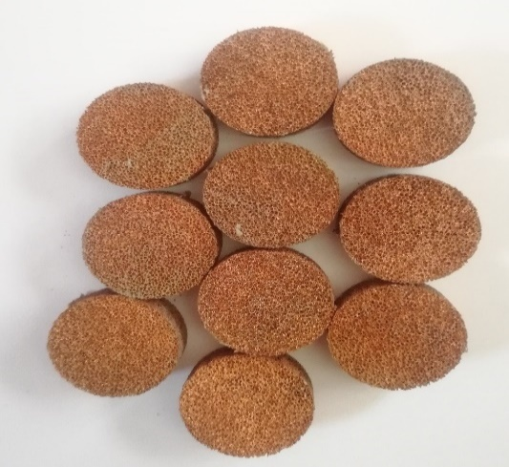
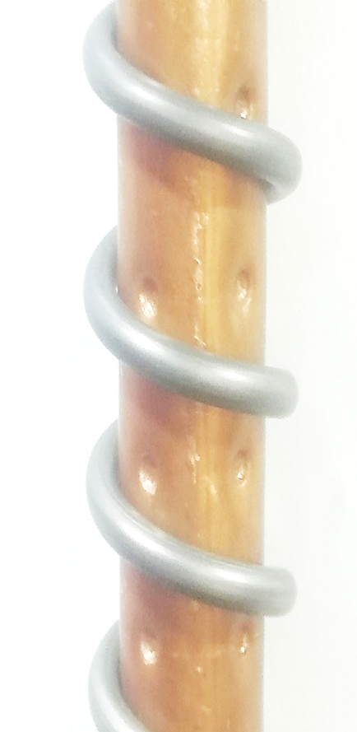
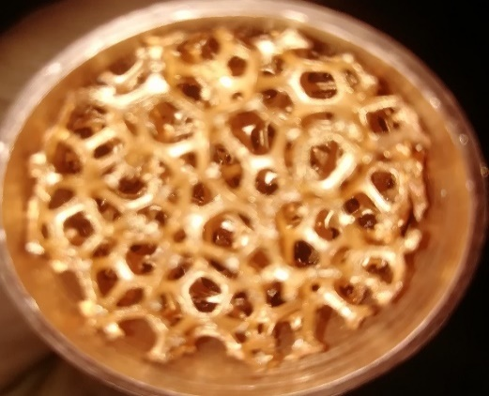
Clear pipe
40PPI
10PPI
Figure 2: Pore density of metal foam
Dimple pipe
Figure 1: Test section of clear and dimple pipe

Slide 16
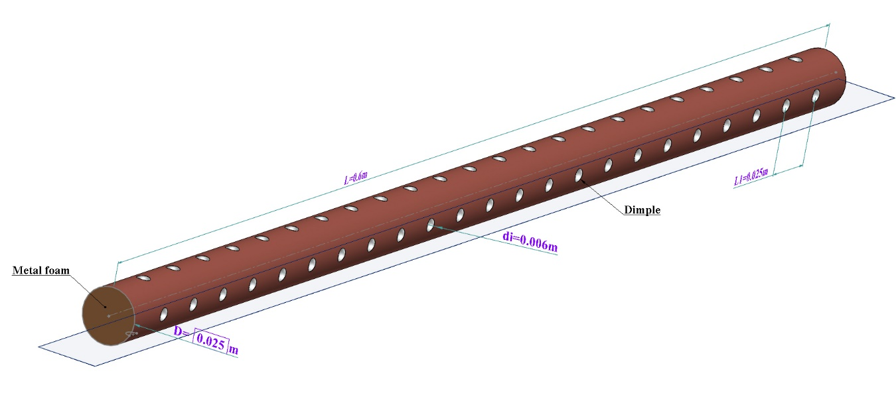
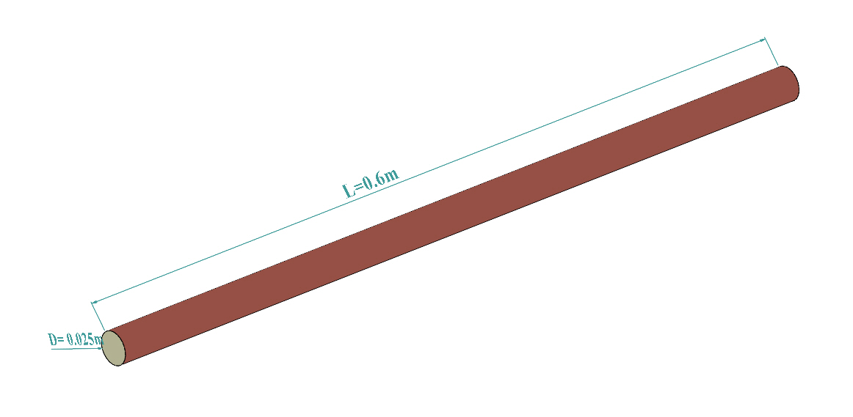
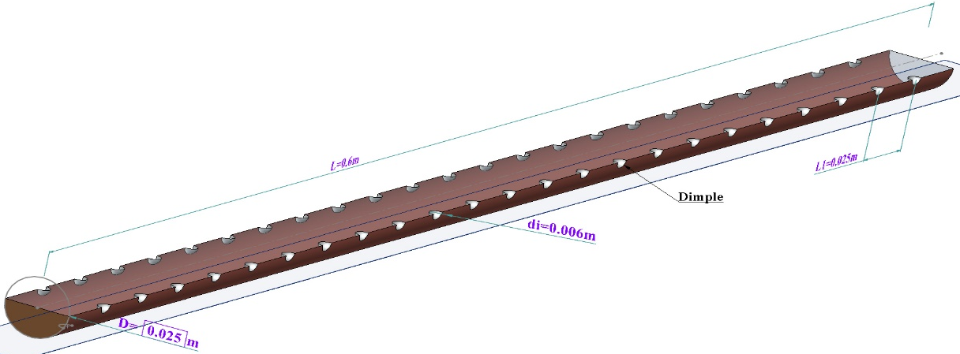
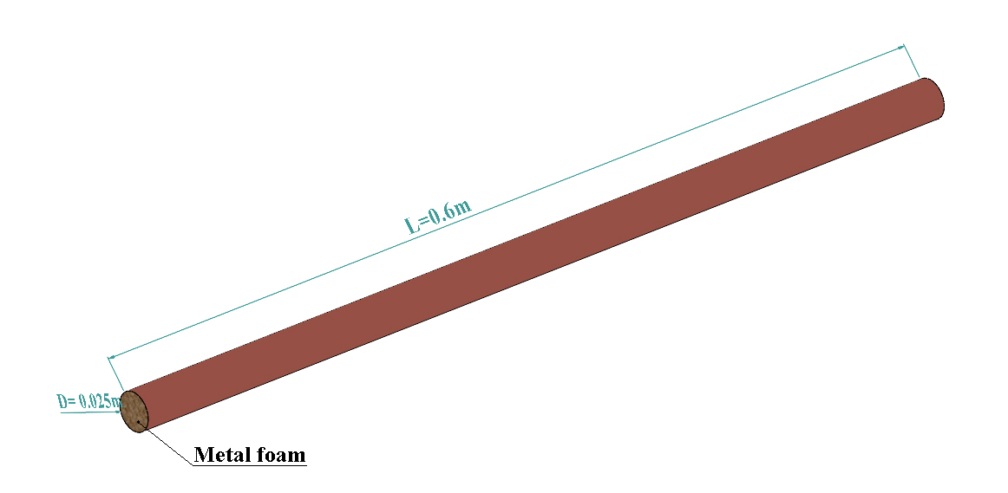
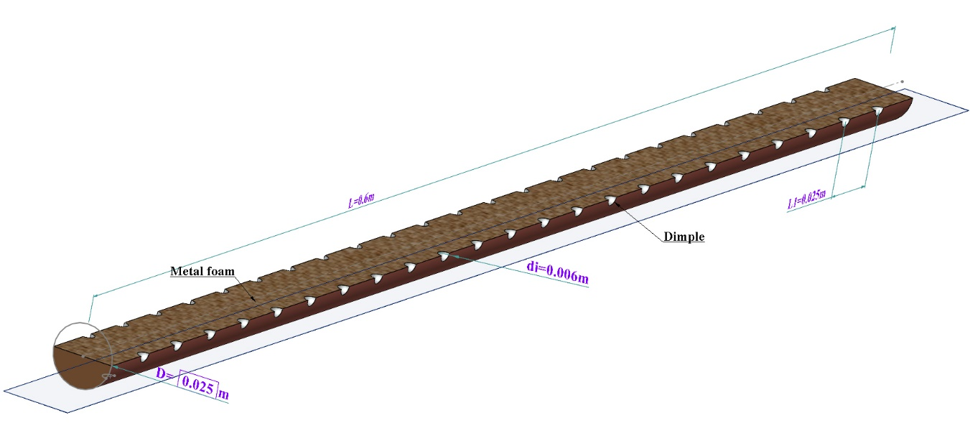
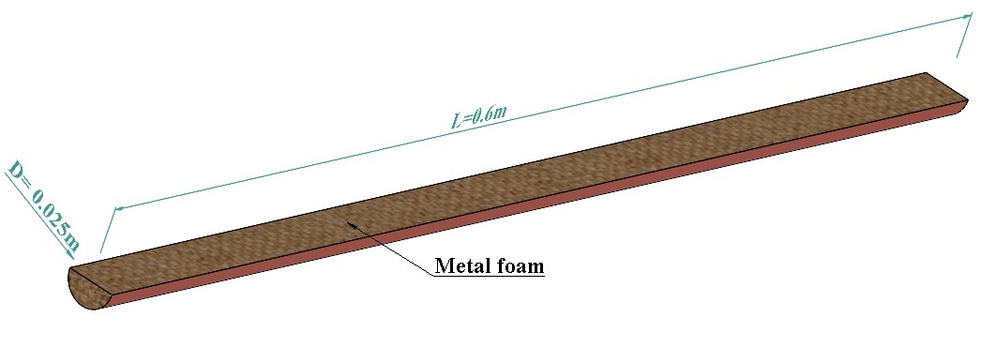
Axial-section dimple pipe
1) Clear pipe
3) Case B
2) Case A
4) Case C

Slide 17
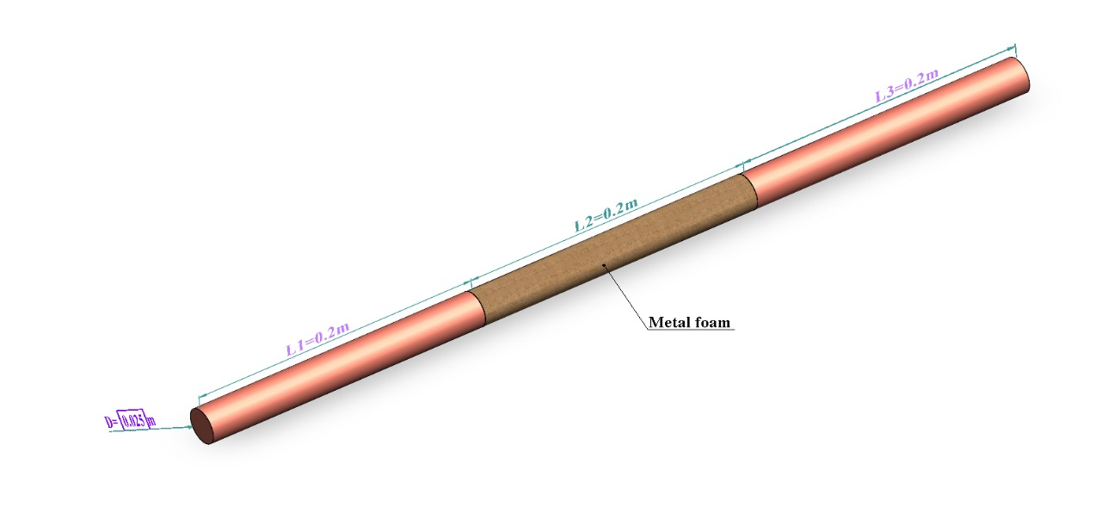
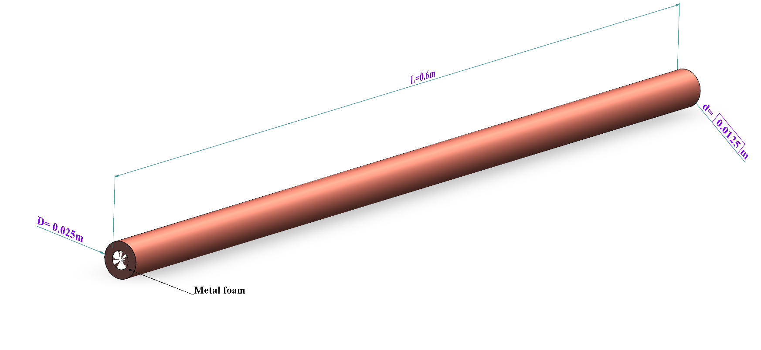
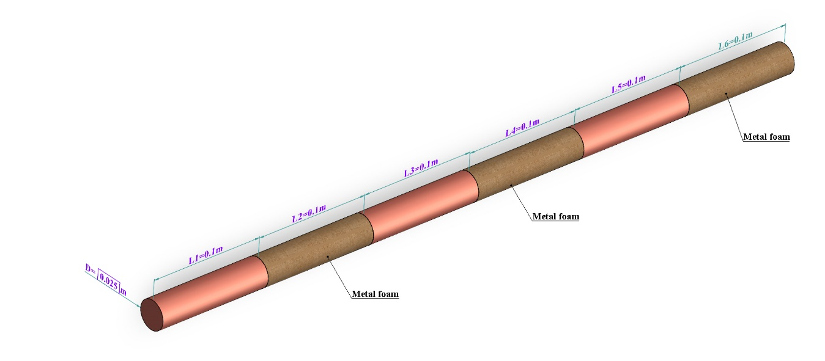
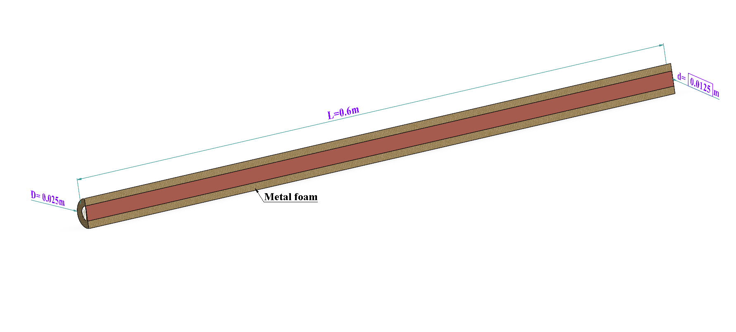
6) Case E
5) Case D
7) Case F

Slide 18
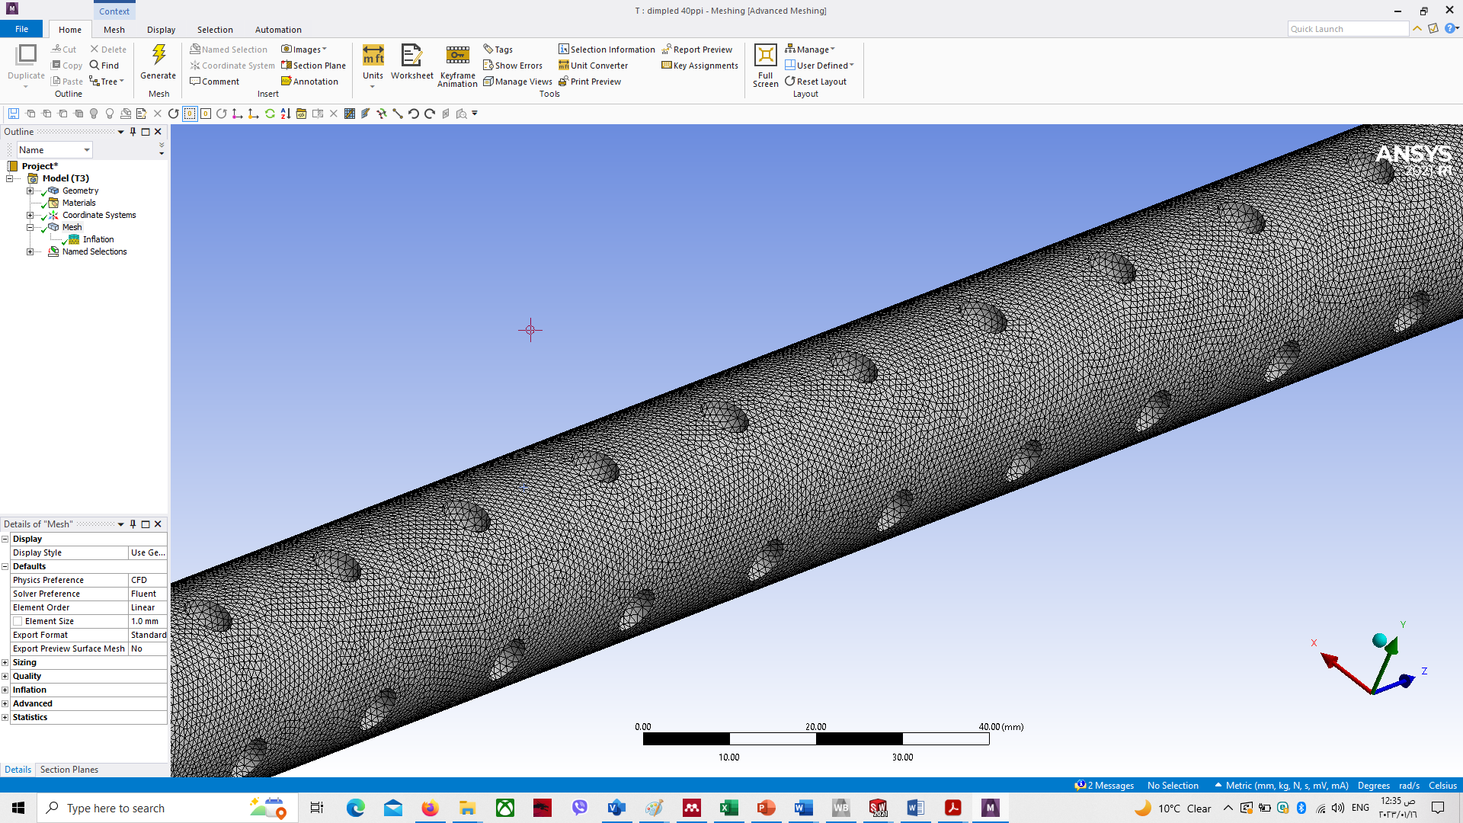
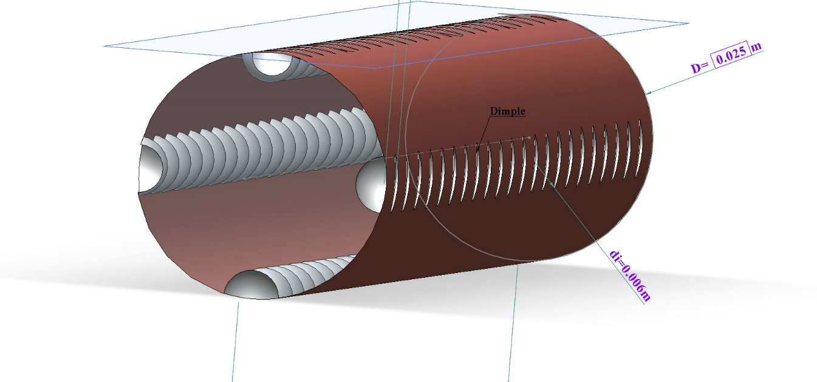
In the numerical part, it was used Ansys fluent program 2021 in different cases, the assumption
Three dimension model
the metal foam is isotropic, homogenous, uniform
constant thermophysical properties of the solid and fluid phases
The working fluid is a Newtonian and incompressible fluid and its flow is turbulent
Porosity 0.9 %, pore density (10,20,30, 40 PPI)
The numerical results are compared with data obtained from experimental work.

Slide 19
Case A
Case B, C
Case D
Case E
Case F

Slide 20
Case A
Case B
Case C
Case D
Case E
Case F

Slide 21
Numerical result, case A, B,C
Experimental result, case A,B,C
Case D
Case E
Case F

Slide 22
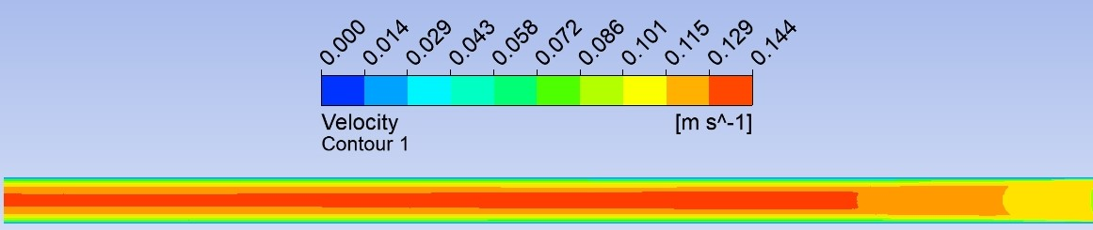
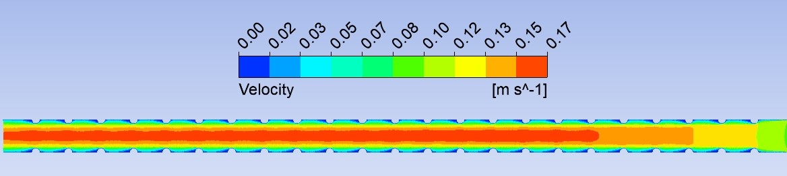
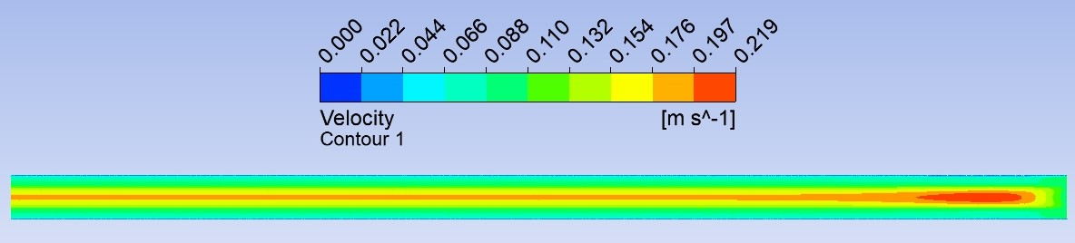
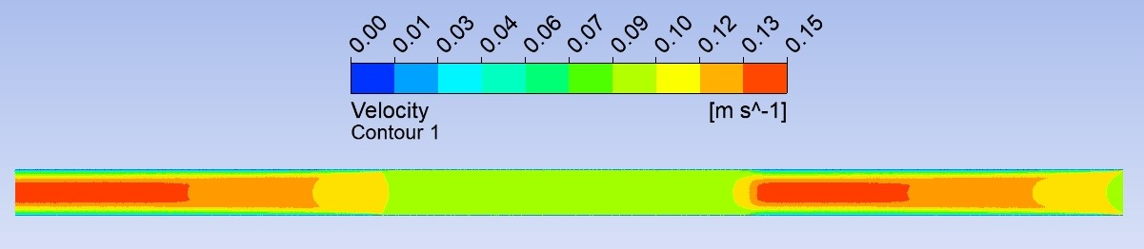
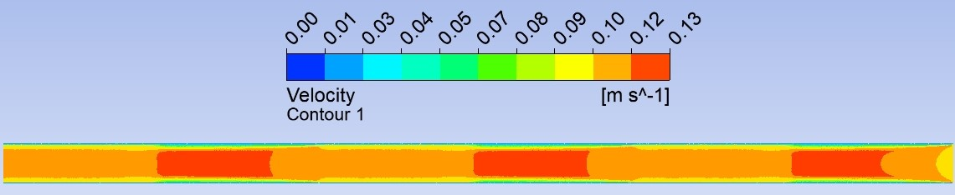
Clear pipe
Case B
Case D
Case E
Case F

Slide 23
THANK You for Attention

