Slide 1

Ministry of Higher Education & Scientific Research
University of Baghdad
College of Engineering
Mechanical Engineering Department
Mathematical modeling based on response-surface methodology
(RSM), experimental investigation and optimization for the laser cutting process.
By:
Sura Sabah Hassan
Supervised by:
Assist .Prof. Basim Shaheen Bachy

Slide 2
Introduction.

Slide 3
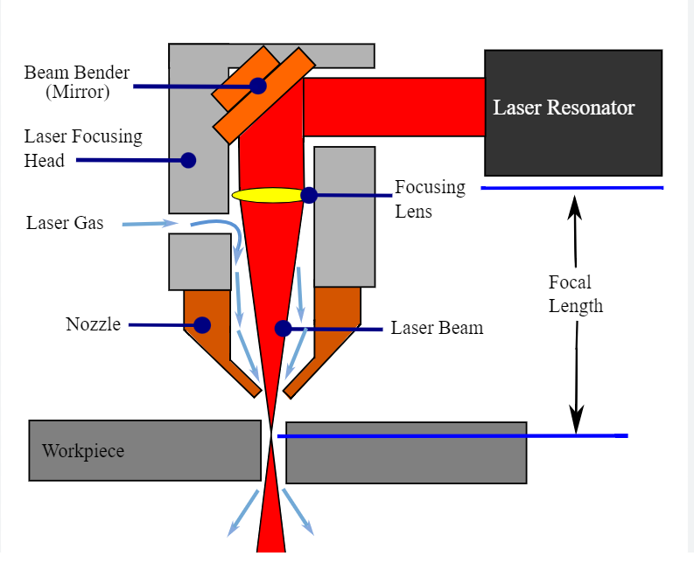
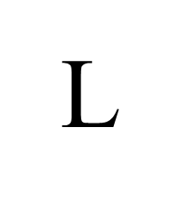




Introduction of Laser Cutting
aser cut is a non-contact process without any tool wear and
ensures a high-quality cut. The transition from mechanical ..… processing to laser machining was primarily driven by the
need to create very small precise features at a high yield and lower cost.
The plastics mostly cut through the vaporizing mechanism .This form is applied to thin portions since a unit quantity of material needs more energy to be removed The accuracy in laser cutting is highly dependent on its quality characteristics such as KW, SR, dross, charring, and width of HAZ. The quality characteristics of the laser cutting are highly dependent on the input parameters, and their levels.
Figure 1. Schematic diagram of the process of materials removal.
Advantages:
The cutting edge resulted in high quality and produced a little kerf
high accuracy.
Non contact process and used In practically all categories of materials, such as metals, non-metals, ceramics, and composites.

Slide 4



Objective of
Project
Studying the effect of cutting process parameters on the material using fiber laser on GFRP composite plates.
Numerical and experimental investigations comparison for the possibility of cutting GFRP composite plates with different parameters.
Using the Numerical optimization method to obtain the osmium cutting .

Slide 5
The Experimental procedure

Slide 6
Measurements and tests
Preparing the equipment and devices
1
2
3
4
Choosing Materials
Selecting cutting
parameters
Choosing Materials GFRP-material made by the LPKF Laser & Electronics AG Company; Germany was employed to investigate the laser parameter influence. The plate dimensions were 60mmx 60mmx2mm.
Preparing the equipment and devices The fiber laser of 1064 nm (CNC machine) 50w with, Plus Duration of 20 ns, Beam diameter 30 𝜇m, and plus frequency 200 kHz was chosen .
Selecting cutting parameters Laser power (20-40)W, Laser cutting speed (10-50) mm/s ,Frequency (50-70)kHz ,and pass number (1-9) were applied
Measurements and tests The results of the cut, such as the depth, top width and taper angle were examined by the microscope.

Slide 7
Experimental
procedure
Figure 2.
Flowchart of the experimental process for this research

Slide 8
Response Surface Design

Slide 9
Response Surface Design
figure 6. Experimental design for three design variables: A)full factorial design, B)box-Behnken design, C) central composite design
RSM-Central composite design (CCD) was design that, along with the three-level elements, includes an axial or star point. The axial or star point, commonly indicated as (á), raised the number of levels to 5, allowing the experimental design to be more flexible. Its advantage over box-Behnken was allowing the experiment designer to understand what influence the variables had on the response when the experimental designer goes over or below the selected levels of factors. Fig 6 shows the difference between the 3 types or response surface methodology
Controllable parameters | Units |  |  | Levels
 |  | -2 | -1 | 0 | 1 | 2
X1. Cutting Speed (V) | mm/sec | 10 | 20 | 30 | 40 | 50
X2. Working Power (P) | Watt | 20 | 25 | 30 | 35 | 40
X3. Pulse Frequency (f) | Hz | 50 | 55 | 60 | 65 | 70
X4. Pass Number (P.N) |  | 1 | 3 | 5 | 7 | 9

Slide 10
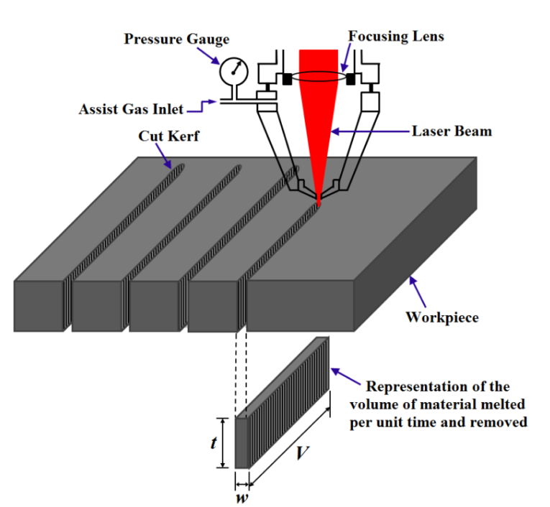
Figure 3. Workpiece before the process
figure 4. Workpiece after the process
figure 5.The used fiber laser (50 w) machine

Slide 11
The Result

Slide 12
 | Parameters |  |  |  |  | Results
TEST NO. | Actual setting of parameters |  |  |  |  | Dimensions of microgroove (𝜇m))
 | Velocity (mm/sec) | Power (W) | Frequency (kHz) | Pass. No |  | Top (𝜇m) | Depth (𝜇m) | Angle (deg)
1 | 20 | 25 | 55 | 3 |  | 351.3 | 1459.5 | 5.317
2 | 40 | 25 | 55 | 3 |  | 305.56 | 934.543 | 7.135
3 | 20 | 35 | 55 | 3 |  | 368.23 | 2000 | 4.183
4 | 40 | 35 | 55 | 3 |  | 320.2 | 1430.92 | 5.3543
5 | 20 | 25 | 65 | 3 |  | 310.12 | 1200 | 8.561
6 | 40 | 25 | 65 | 3 |  | 308.45 | 1012.62 | 8.329
7 | 20 | 35 | 65 | 3 |  | 356.6 | 2000 | 3.7823
8 | 40 | 35 | 65 | 3 |  | 319.56 | 1524.517 | 3.8806
9 | 20 | 25 | 55 | 7 |  | 358.2 | 2000 | 3.746
10 | 40 | 25 | 55 | 7 |  | 354.2 | 1531.73 | 4.037
11 | 20 | 35 | 55 | 7 |  | 370.11 | 2000 | 3.8746
12 | 40 | 35 | 55 | 7 |  | 364.21 | 2000 | 4.8676
13 | 20 | 25 | 65 | 7 |  | 362.33 | 2000 | 6.3053
14 | 40 | 25 | 65 | 7 |  | 355 | 2000 | 3.9773
15 | 20 | 35 | 65 | 7 |  | 370.35 | 2000 | 3.6943
16 | 40 | 35 | 65 | 7 |  | 365.21 | 2000 | 3.6147
17 | 10 | 30 | 60 | 5 |  | 368.29 | 2000 | 4.6
18 | 50 | 30 | 60 | 5 |  | 315.33 | 1480.51 | 4.688
19 | 30 | 20 | 60 | 5 |  | 309.5 | 1126.5 | 6.035
20 | 30 | 40 | 60 | 5 |  | 357 | 2000 | 2.8906
21 | 30 | 30 | 50 | 5 |  | 355.4 | 1552.47 | 3.4553
22 | 30 | 30 | 70 | 5 |  | 360.4 | 2000 | 3.6463
23 | 30 | 30 | 60 | 1 |  | 310.7 | 1390.428 | 8.4863
24 | 30 | 30 | 60 | 9 |  | 367.65 | 2000 | 5.8763
25 | 30 | 30 | 60 | 5 |  | 369.54 | 2000 | 3.3555
26 | 30 | 30 | 60 | 5 |  | 369.54 | 2000 | 3.3555
27 | 30 | 30 | 60 | 5 |  | 369.54 | 2000 | 3.3555
28 | 30 | 30 | 60 | 5 |  | 369.54 | 2000 | 3.3555
Table 2.
Experimental Measurements.

Slide 13
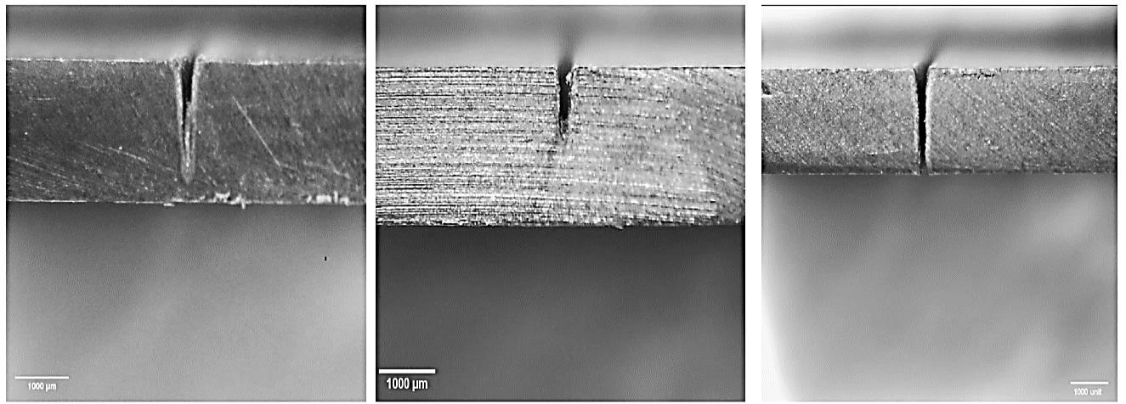
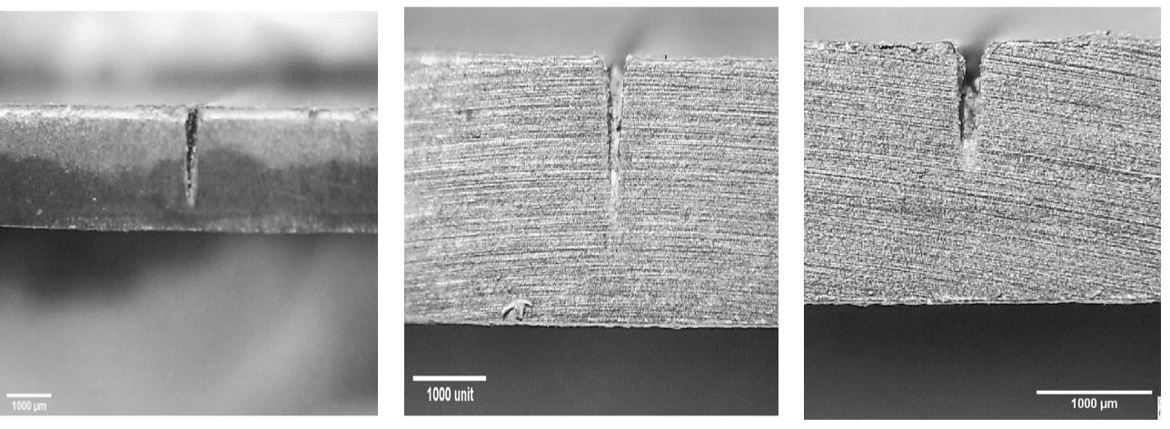
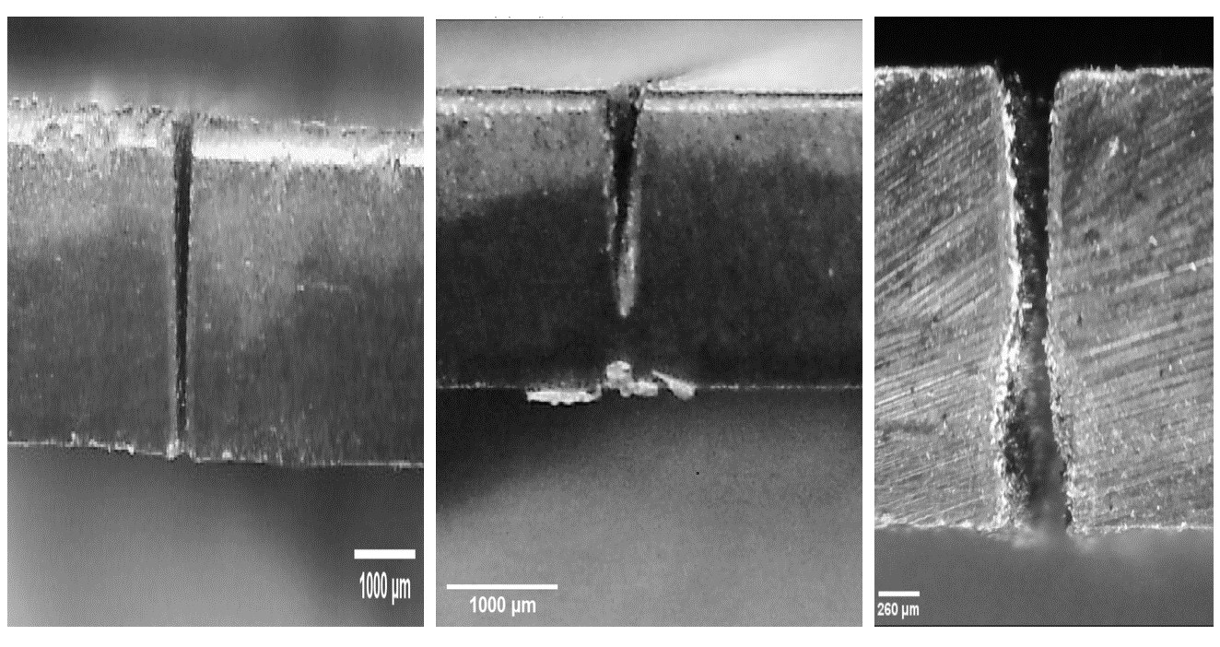
RUN.
RUN.2
RUN.3
1
Figure 6.
topography images for 2mm thickness of PEEK first group RUNS1-9.
Run.
Run.5
4
Run.
6
Run.
Run.
9
Run.
8
7
Figure 5.7. Topography images for 2mm thickness of PEEK. Second group Runs 10-18.
Figure 5.8 Topography images for 2mm thickness of PEEK. last Group RUNS19-28

Slide 14
The Mathematical Result

Slide 15
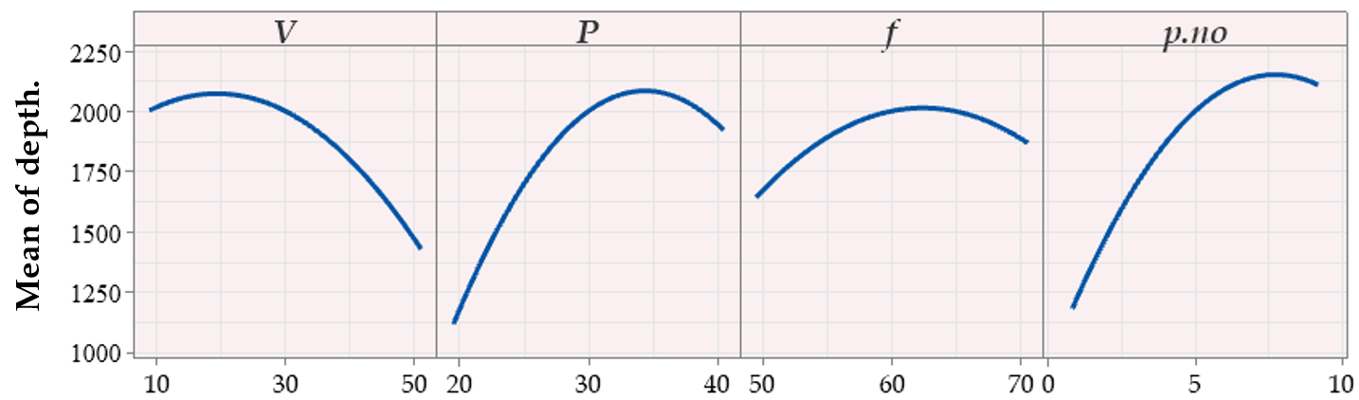
Table 3. ANOVA result for depth model
Figure 7. The interaction between the process parameters and its effect on depth cut.
Depth = -11666 - 67.8 V + 381.0 P + 239 f + 333 p.no - 0.642 V*V - 4.34 P*P - 2.21 f*f - 20.03 p. no*p.no + 0.170 V*P + 1.124 V*f + 4.03 V*p.no - 0.48 P*f - 11.75 P*p.no + 3.48 f*p.no…………………………………………………………eq5.1

Slide 16
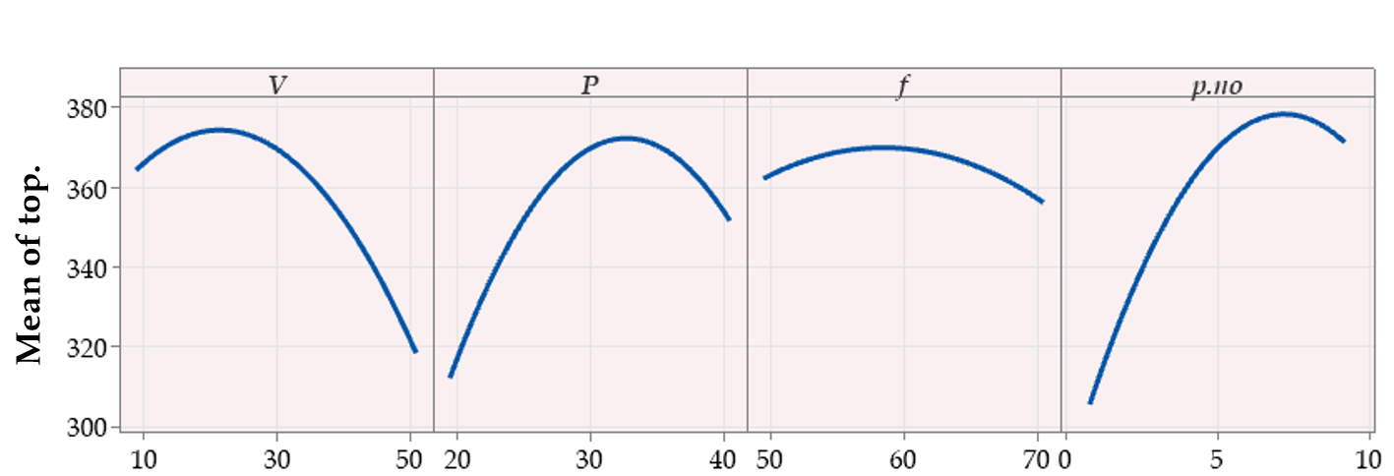
Table 4. ANOVA result for top model
Figure 8. The interaction between the process parameters and its effect on the groove top
Top = -139 - 1.50 V + 21.95 P + 5.71 f + 3.0 p.no - 0.0640 V*V - 0.3416 P*P - 0.0951 f*f - 1. 765p.no*p.no - 0.0467 V*P + 0.0656 V*f + 0.3441 V*p.no + 0.0558 P*f-0.306P*p.n +0.355f*p.no………..……………………eq 2

Slide 17
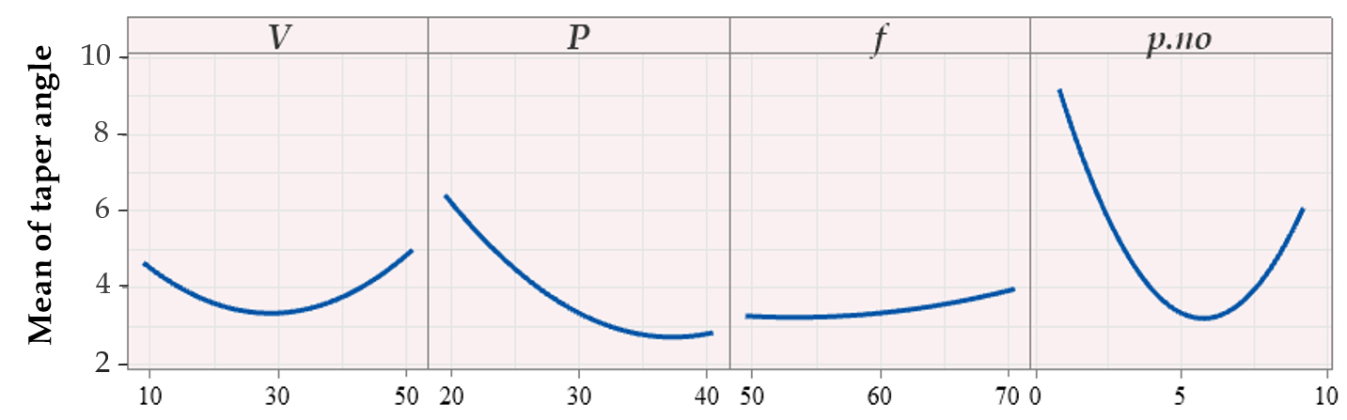
Table 5.ANOVA result for taper angle model
Figure 9. The interaction between the process parameters and its effect on taper angle.
.
Angle = -17.1 + 0.281 V + 0.254 P + 0.804 f - 3.757 p.no + 0.003356 V*V + 0.01162 P*P + 0.00250 f*f+ 0.2425 p. no*p.no + 0.00329 V*P - 0.00852 V*f- 0.01244 V*p.no - 0.02561P*f+0.06330P*p.no-0.00936f*p.no. …… eq5.3

Slide 18
The Impertinences of Laser Parameters.
PARAMETERS | DEPTH | TOP WIDTH | TAPER ANGLE
velocity | 0.126 | 0.180 | 0.002
power | 0.247 | 0.133 | 0.233
Frequency | 0.0192 | 0.003 | 0.009
passes number | 0.328 | 0.370 | 0.174

Slide 19
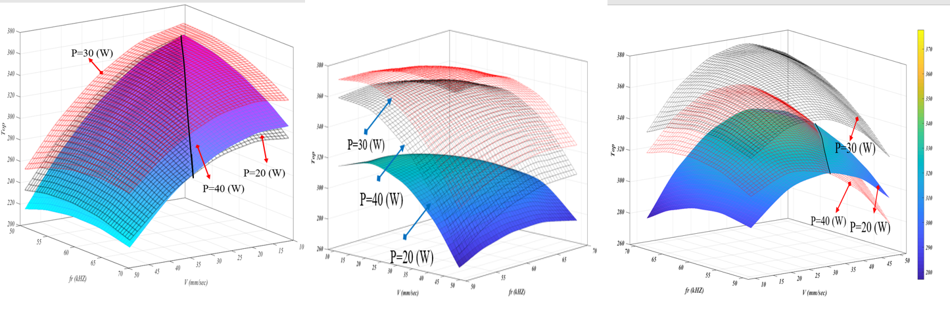

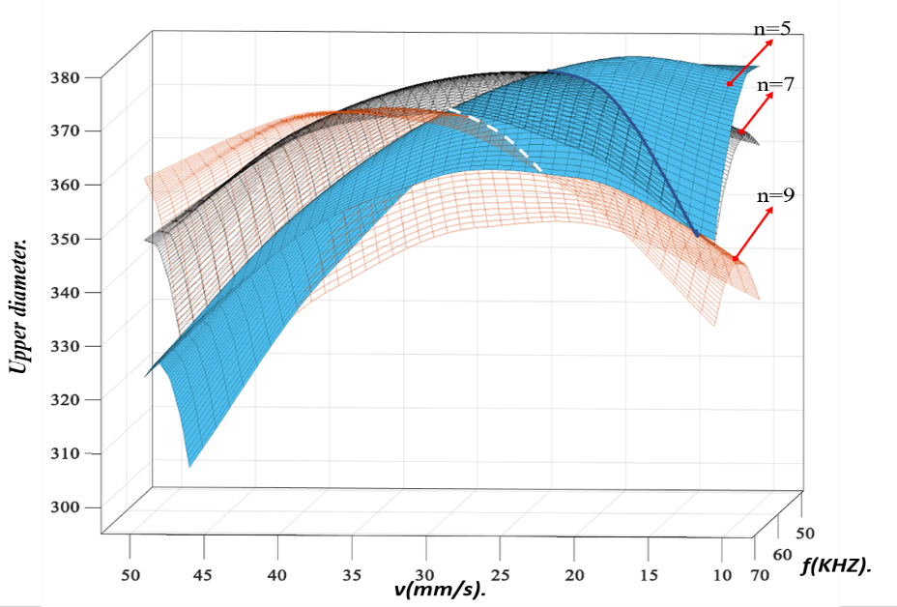
Figure 10
The interaction between the process parameters and its effect on top at n=1. , n=5
Figure 11
The interaction between the process parameters and its effect on top at n=9. , power =35W

Slide 20
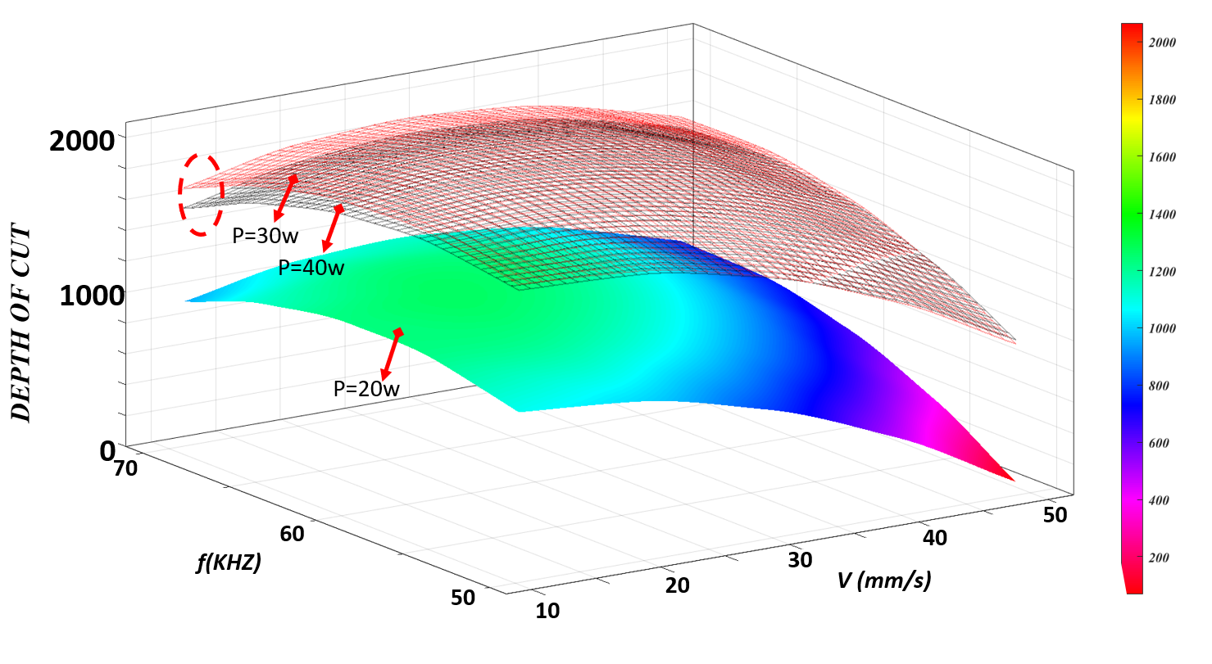
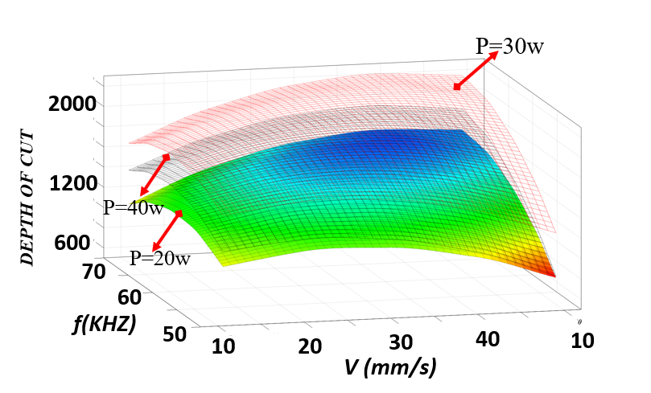
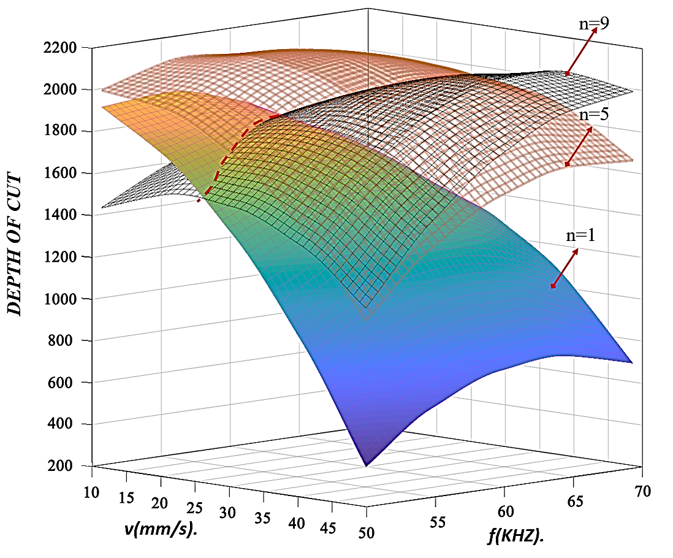
Figure 12
The interaction between the process parameters and its effect on depth at n=9. , n=5, power 35W

Slide 21
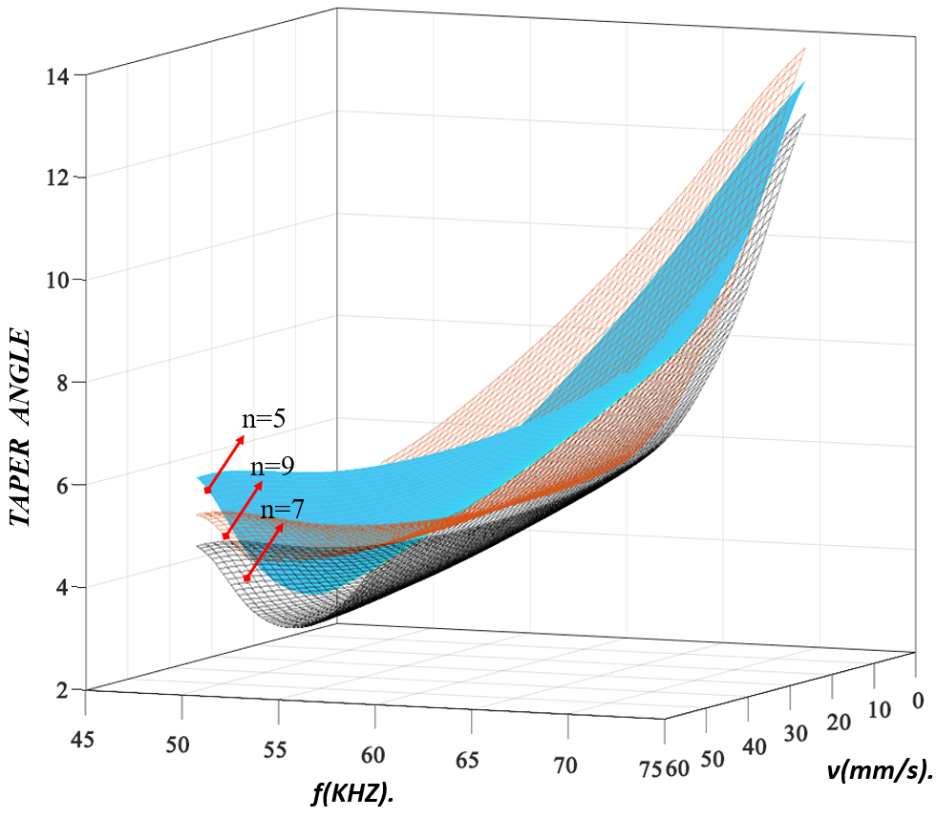
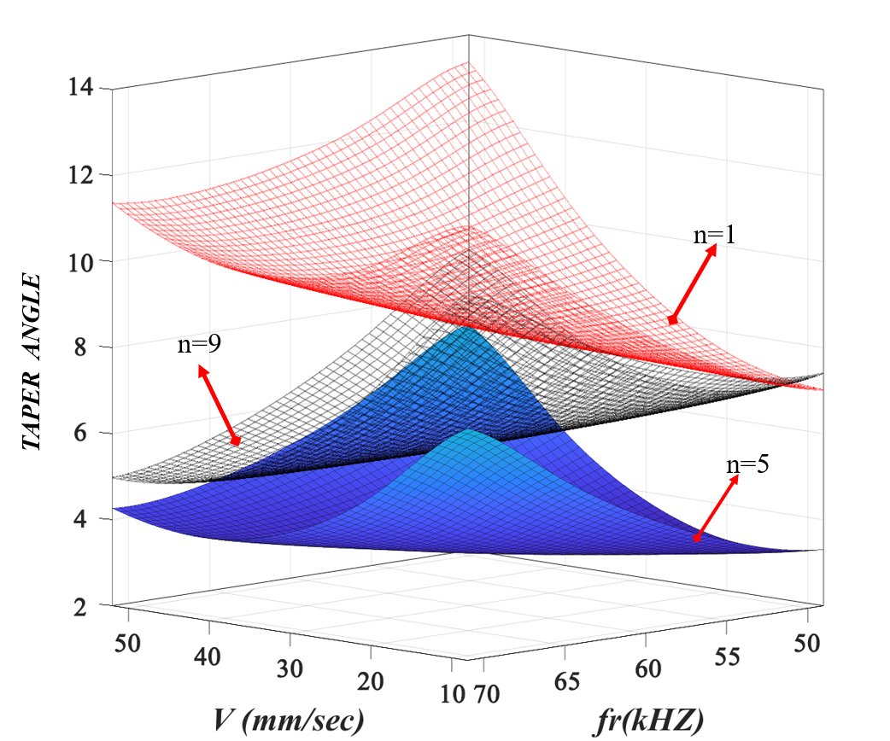
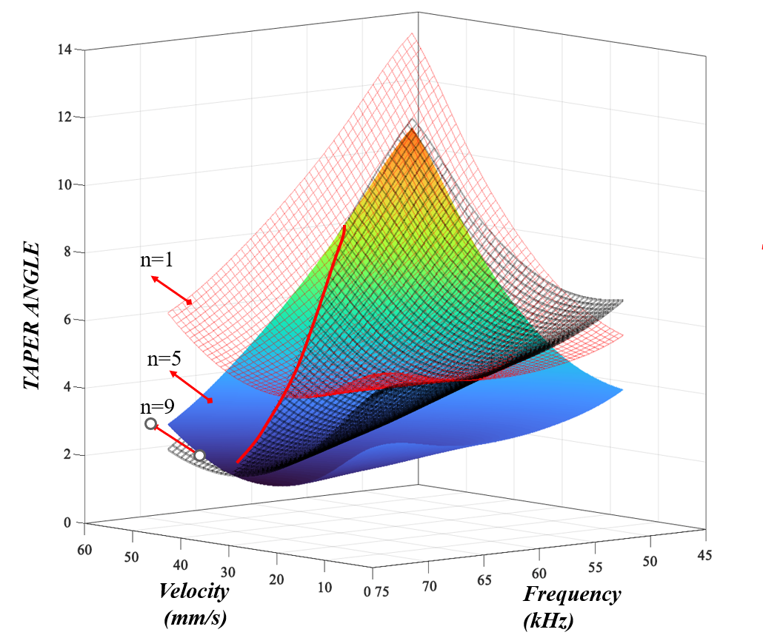
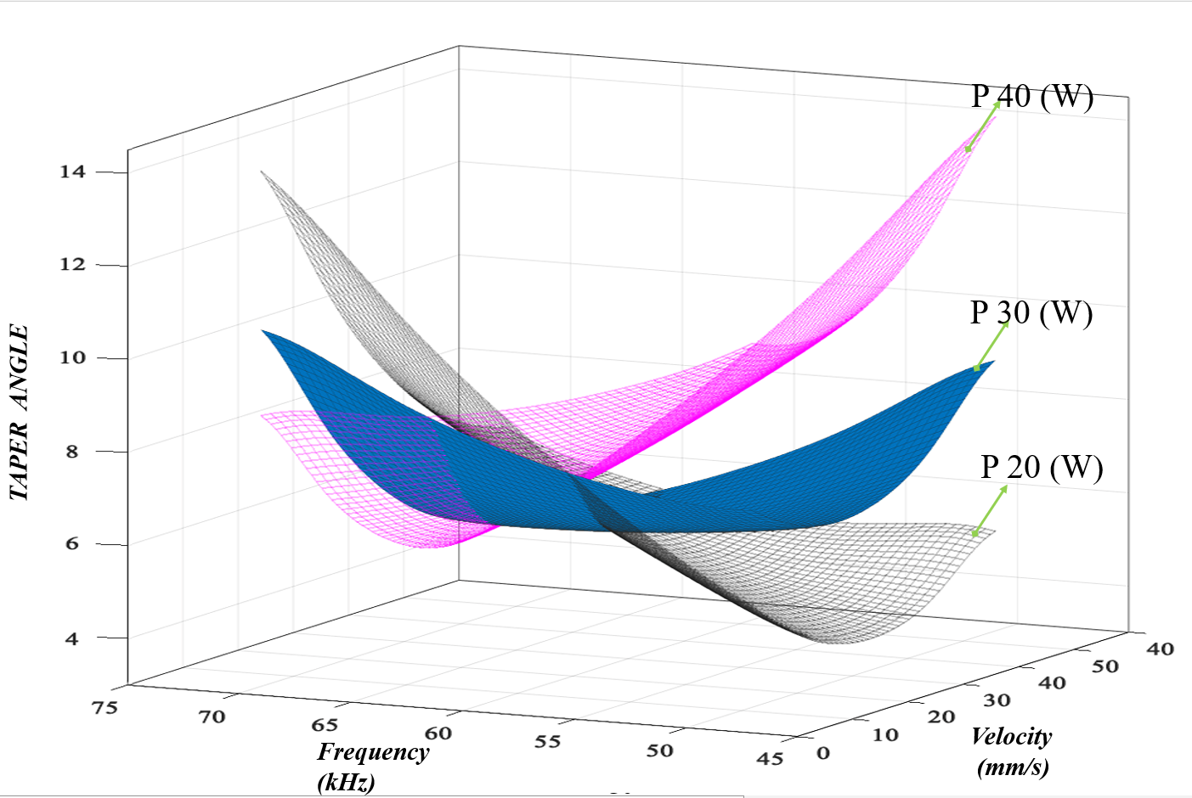
Figure 13
The interaction between the process parameters and its effect on taper angle at
power 20W. , 30W ,
figure 14
The interaction between the process parameters and its effect on taper angle at
power,40W ,n=9

Slide 22
Validation and Accuracy of modeling
3.627% for depth, 1.149% for upper width, and 4.3180% for taper angle.,
Figure 14
comparison between experimental and predicted result and the error

Slide 23
The numerical optimization technique.
Optimization uses probabilistic principles to minimize or maximize the objective function rather than deterministic ones, overcoming the constraints of traditional approaches
The optimum demonstrated that the best parameters 23 mm/sec, 33 w, 60khz, and 5 passes with 2.712 o 359,271 mm of upper width and a full cut of 2000𝜇m
Figure 15
comparison between experimental and predicted result for the optimization parameters

Slide 24
Conclusions
A laser power (25 to 40) w, cutting velocity (20 to 50) mm/s, laser frequency (55 to 70) kHz, and pass number (3 to 9) per pass achieved a full cutting depth.
2. The second order mathematical model was effective in investigating this material and can be used to optimize the micro-cutting process with nano fiber laser and GFRP material. Also, ANOVA test showed that depth, top width and taper angle, were strongly influenced by the laser power, pass number, laser velocity and frequency. The laser frequency had no effect at high to medium numbers of passes and laser power.
3. At medium to high 5-9 passes, the effect of the pass number and laser power on the profile and dimensions was always stronger than that of the frequency of laser and laser velocity. The minimum top kerf width was 305.56 μm at a laser power of 25 w, laser velocity of 40mm/s, laser frequency of 55khz and 3 passes, while the highest width value was 370 at laser power of 35 w laser velocity of 20mm/s, laser frequency in range of (55 to 65) kHz and 7 passes.
4. Small kerf tapers produced a high pass number and laser power. In general. Higher passes increased the focal length, which decreased the energy transfer. The minimum angle was 2.8906o at a laser power of 40w, laser velocity of 30mm/s, laser frequency of 60khz and 5 passes, while the maximum reached 8.561o at a laser power of 25w, laser velocity of 20mm/s, laser frequency of 65khz and 7 passes.
5. The predicted data agrees well with the experimental data. The prediction errors reached 3.627% for depth, 1.149% for upper width, and 4.3180% for taper angle. Because of its high level of precision, the (RSM-CCD) model was useful for modeling, analysis, and optimization. The optimum demonstrated that the best parameters 23 mm/sec, 33 w, 60khz, and 5 passes with 2.712 o 359,271 mm of upper width and a full cut of 2000𝜇m.

Slide 25
Future work.
In spite of the fact that the investigation found evidence of fiber laser micro-cutting to thermoplastics polymer that was reinforced by fiber glass within the limits of its scope, this was important to give the following recommendations.
Further process parameters such as focusing diameter and cutting strategy could be considered to figure out there affect the cutting process.
2. Material more than 2mm thickness to examined the effect of the process parameters on the micro-cutting quality.
3. A computer simulation tool involving thermal simulation for the laser micro-cutting process could be used as an important tool to understand and analyze the investigated process.

Slide 26
List of Publications
Sura S. Hassan,, and Basim Shaeen Bachy, “On the Laser Micro cutting: Experimentation and Mathematical Modeling based on RSM-CCD”. Published in Journal of Engineering, 2023.
Sura S. Hassan, and Basim Shaeen Bachy, “Mathematical Modeling Based on Response-Surface Methodology (RSM), Experimental Investigation, and Optimization of the Laser Cutting Process”. Unpublished in International Journal of Mechanical Sciences, 2023

Slide 27
Thank You
For Listening

