Slide 1


Thermal Performance of Radiant Floor Cooling With Phase Change Material For an Energy Efficient Building.
Notes:
الأداء الحراري للتبريد الأرضي المشع مع مادة تغيير الطور لمبنى موفر للطاقة.

Slide 2
Prof. Dr. Najm Abd Jasim.
Ph.D.Student: Qusay Kamil Jasim.

Slide 3
OBJECTIVES
1
To Evaluate the energy and thermal performance of a (RCS) with integrated PCMs for an energy efficient building.
2
To shift the energy from night time to peak time it is required to store thermal energy by using an indoor Thermal Energy Storage (TES).
3
Comparison between the two test rooms thermal performance by using with/without phase change materials.
4
The use of a hybrid system, which is a combination of several integrated systems to provide energy and convert it to cool the space, such as a solar system.

Slide 4
OBJECTIVES
5
Temperature distribution of room test during daily time with/without phase change materials.
6
Improvement thermal performance of PV panels.
7
Improvement Coefficient of performance of A/C.
8
simulate the proposed system using suitable energy software.

Slide 5
APPLICATIONS IN BUILDINGS
WALLS 2)ROOFS
3)FLOORS 4)COMBIND

Slide 6

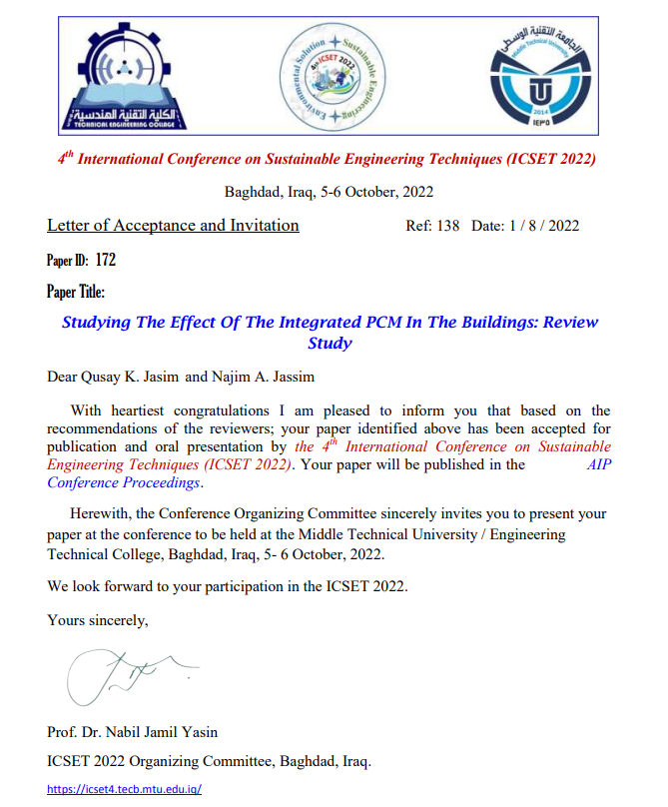

Slide 7
Current work
Theoretical
Experimental

Slide 8
Theoretical Part
1
Ansys Fluent for TES.
2
HAP for A/C System
3
MATLAB simulation for PV panels

Slide 9
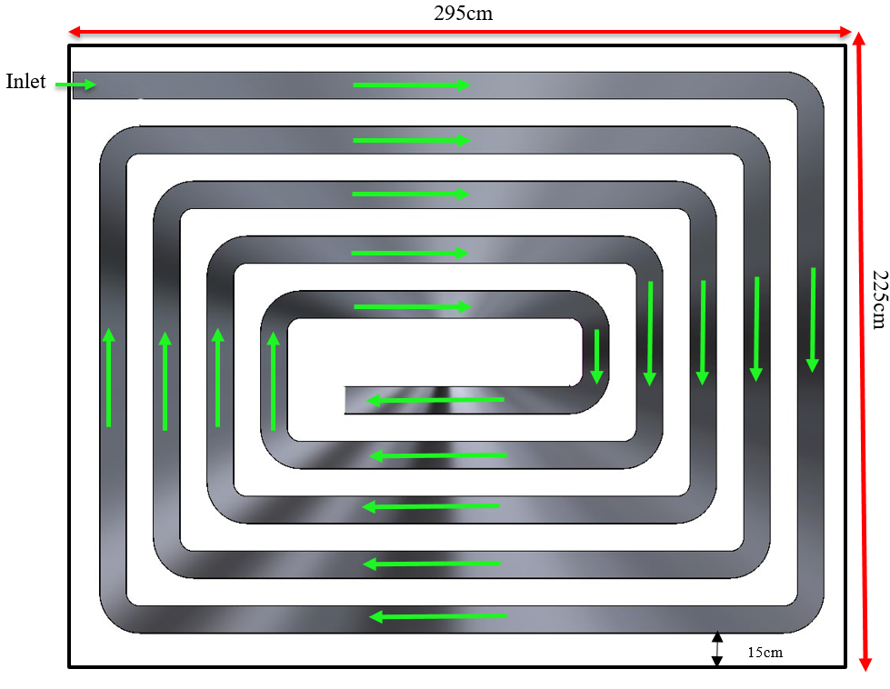
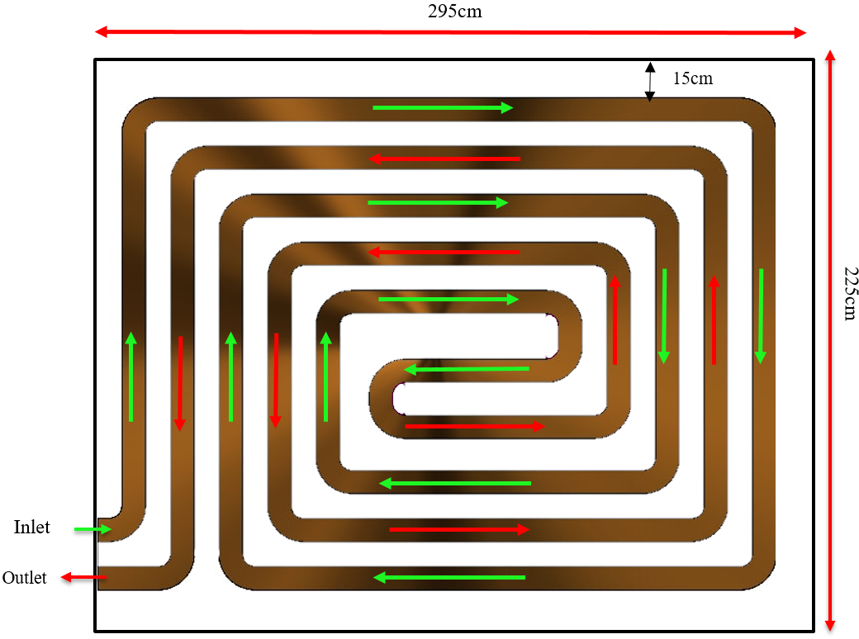
Counter-flow
Spiral-flow

Slide 10


Governing Equations
Continuity Equation
$$\frac{∂ρ}{∂τ}+∇.(ρ\overline{V })$$
2) Momentum Equations
$$ρ\left(\frac{∂\overline{V}}{∂τ}+\left(∇.\overline{V}\right)\overline{V} \right)=μ\left(∇^{2}\overline{V}\right)−∇P+\overline{S}$$
where μ is the viscosity of the PCM, P is the pressure, the vector $\overline{S}$ is a global source term is given by the following form:
$$\overline{S}=\frac{{\left(1−β\right)}^{2}}{\left(β+ε\right)} .A_{much}\overline{V}$$
The value of the liquid fraction, (β), is
$β=0 for T<T_{Solid}$
$β=\frac{T−T_{Solid}}{T_{Liquid}−T_{Solid}}$ $for { T}_{Liquid}<T<T_{Solid}$
$β=1 for T>{ T}_{Liquid}$
3) Energy equation
$$\frac{∂}{∂τ} \left(ρH\right)=∇\left(k_{i}∇T\right)$$
The connection between enthalpy and temperature of PCM is as follows:
$$H=C_{PS} T for T<T_{Solid}$$
$H=H_{S}+\frac{H_{m}\left(T−T_{Solid}\right)}{\left(T_{Liquid}−T_{Solid}\right)}$ $for { T}_{Liquid}<T<T_{Solid}$
$$H=H_{L}+C_{Pl} \left(T−T_{Liquid}\right) for T>{ T}_{Liquid}$$

Slide 11
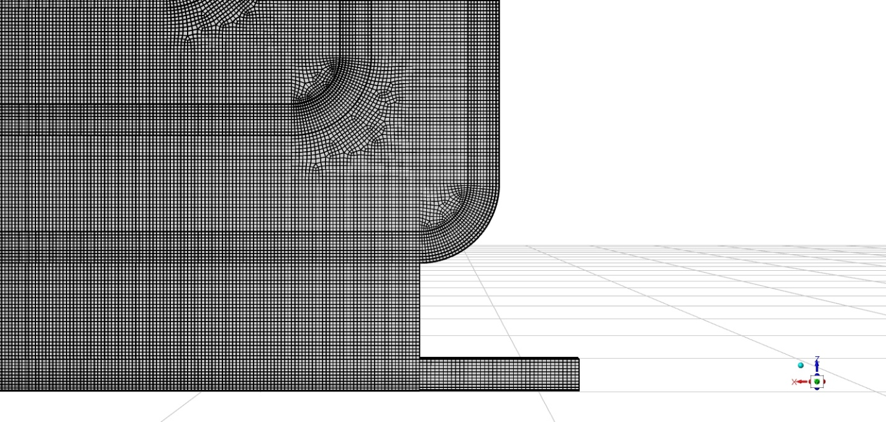

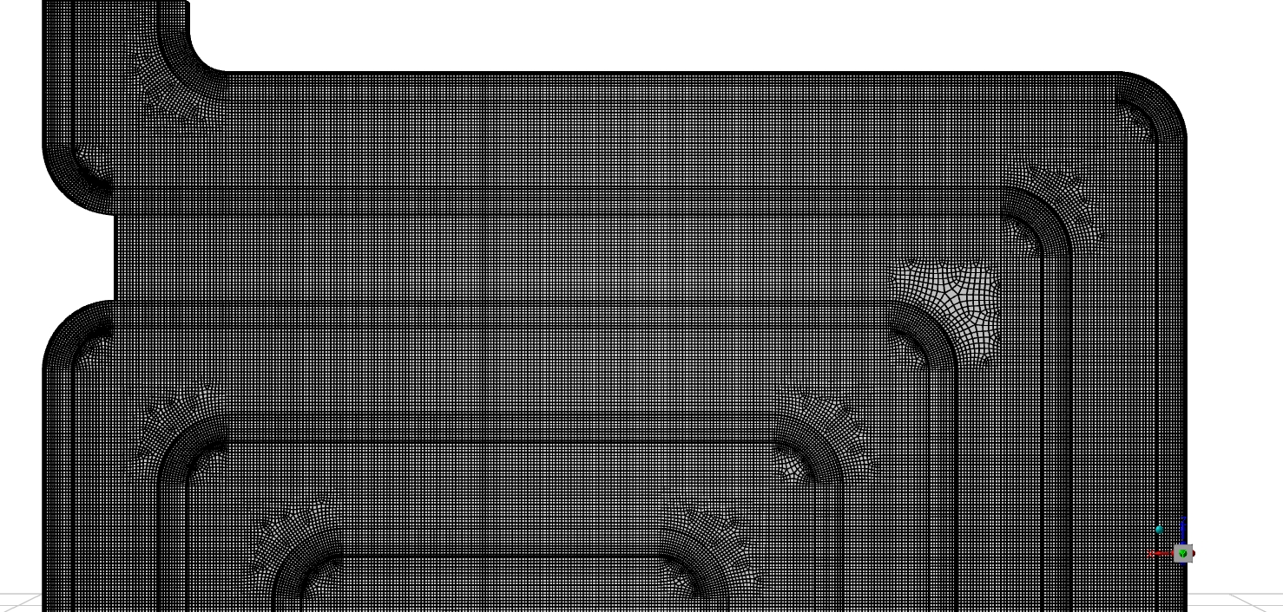
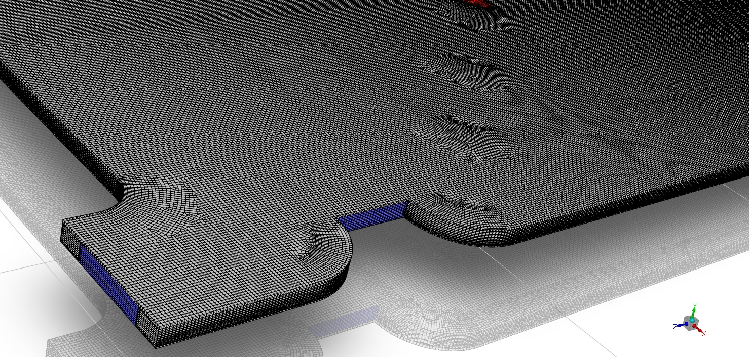
MESH GEN.

Slide 12
Experimental part

Slide 13
EXPERIMANTAL SET UP
1
Two Test Room(TTR)
2
Thermal Energy Storage(TES)
3
Phase change material(PCM)
4
Solar system(SS)
5
Air-Condition Unit(A/C) & Evaporator Air- Cooler(EAC)

Slide 14
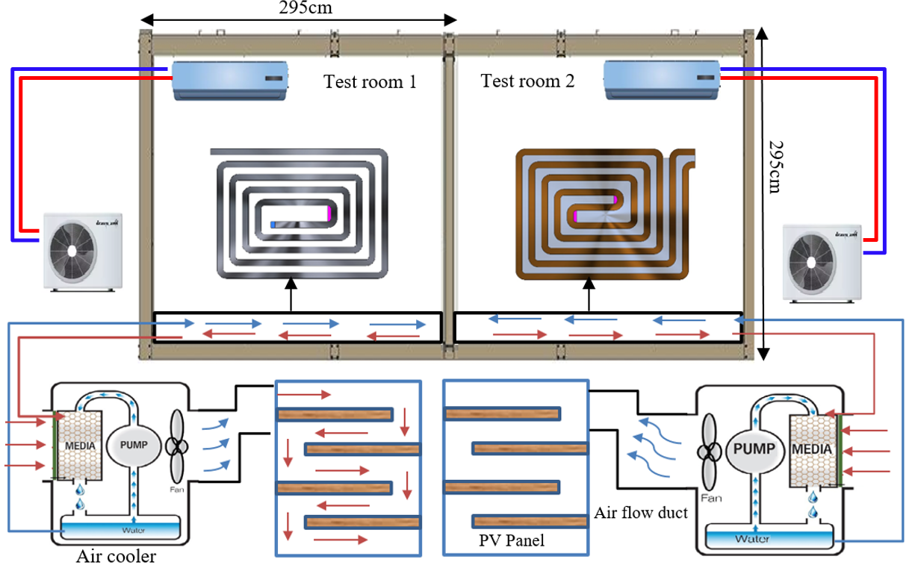

Slide 15
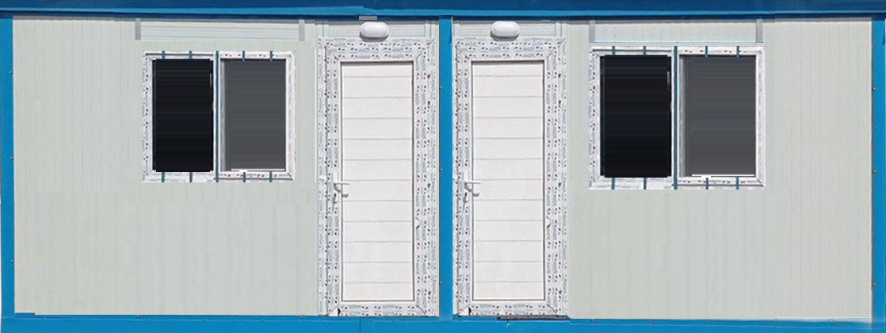
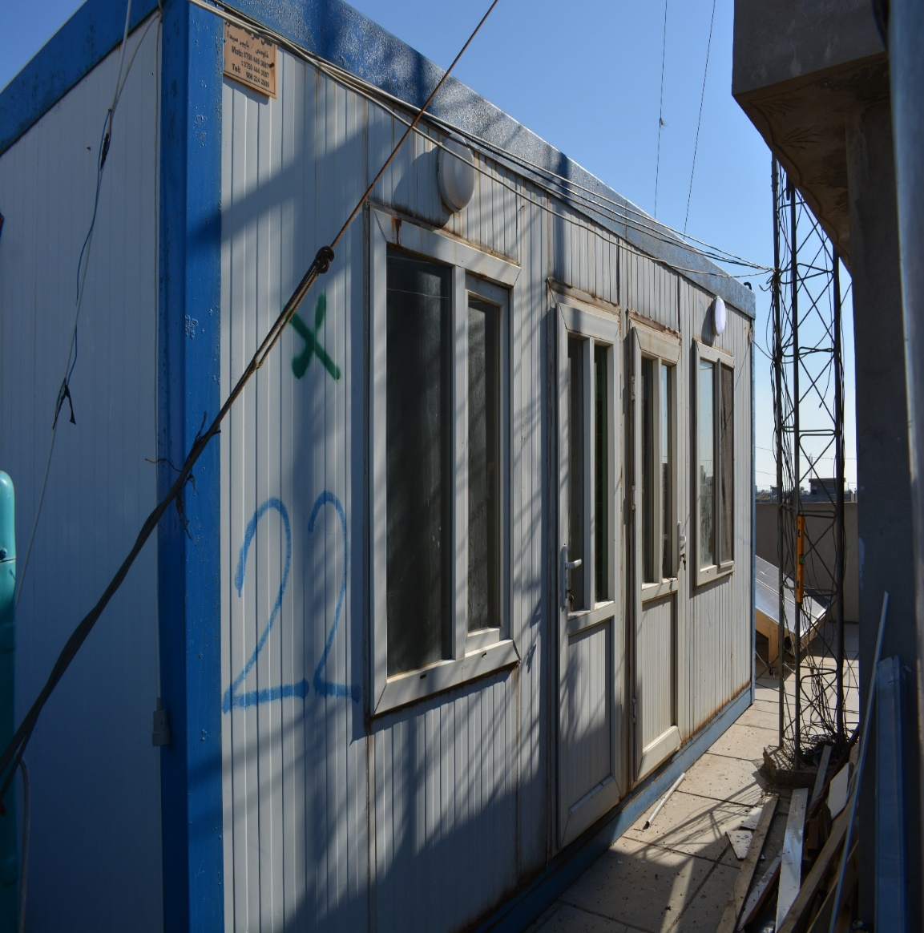
Two Test Room(TTR)
90cm
200cm
295cm
60cm
90cm
2.95m
2.95m
Test Room:( 2.95x2.95x2.25m)

Slide 16
Counter-flow
Spiral-flow

Slide 17



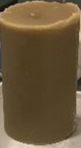
Phase change material(PCM)
Phase Change Material (PCM) is a substance that releases or absorbs enough energy to generate useful heat or cooling at a phase transition. Paraffin wax is one of the most important organic materials, as its melting temperature ranges between 20 - 70 degrees Celsius. Paraffin is considered one of the safe materials, and it has a low thermal conductivity, especially the materials in its solid state. The table (1) shows the properties of the paraffin wax used.
Property | Measure
Melting Point | 48 °C
Oil Content | 1.5 %
Color | Cay bolt (min)
Specific Heat | 2.1kJ/kg.°C
Thermal Conductivity | 0.2W/m.k
Density | 880 kg/m3
Enthalpy of Fusion | 210kJ/kg
PCM: Paraffin wax
Notes:
هي مادة صلبة ناعمة في درجة حرارة الغرفة مشتقة من النفط أو الفحم الصيغة الكيميائية العامة هي (CnH2n + 2). اشتق اسم (برافين) من كلمة "parum" اللاتينية والتي تعني (بالكاد أو نادرًا) وكلمة "affinis" التي تعني «قليل التفاعل» في إشارة إلى طبيعة هذا الشمع الخاملة غير القابلة للتفاعل يستعمل البرافين في العزل الكهربائي والمنتجات المطاطية صناعة الشمع والتشحيم وفي تلميع الجلود. شمع البارافين مادة ممتازة لتخزين الحرارة، له سعه حرارية تتراوح من 2.14 إلى 2.9 (جول لكل غرام كلفن).

Slide 18
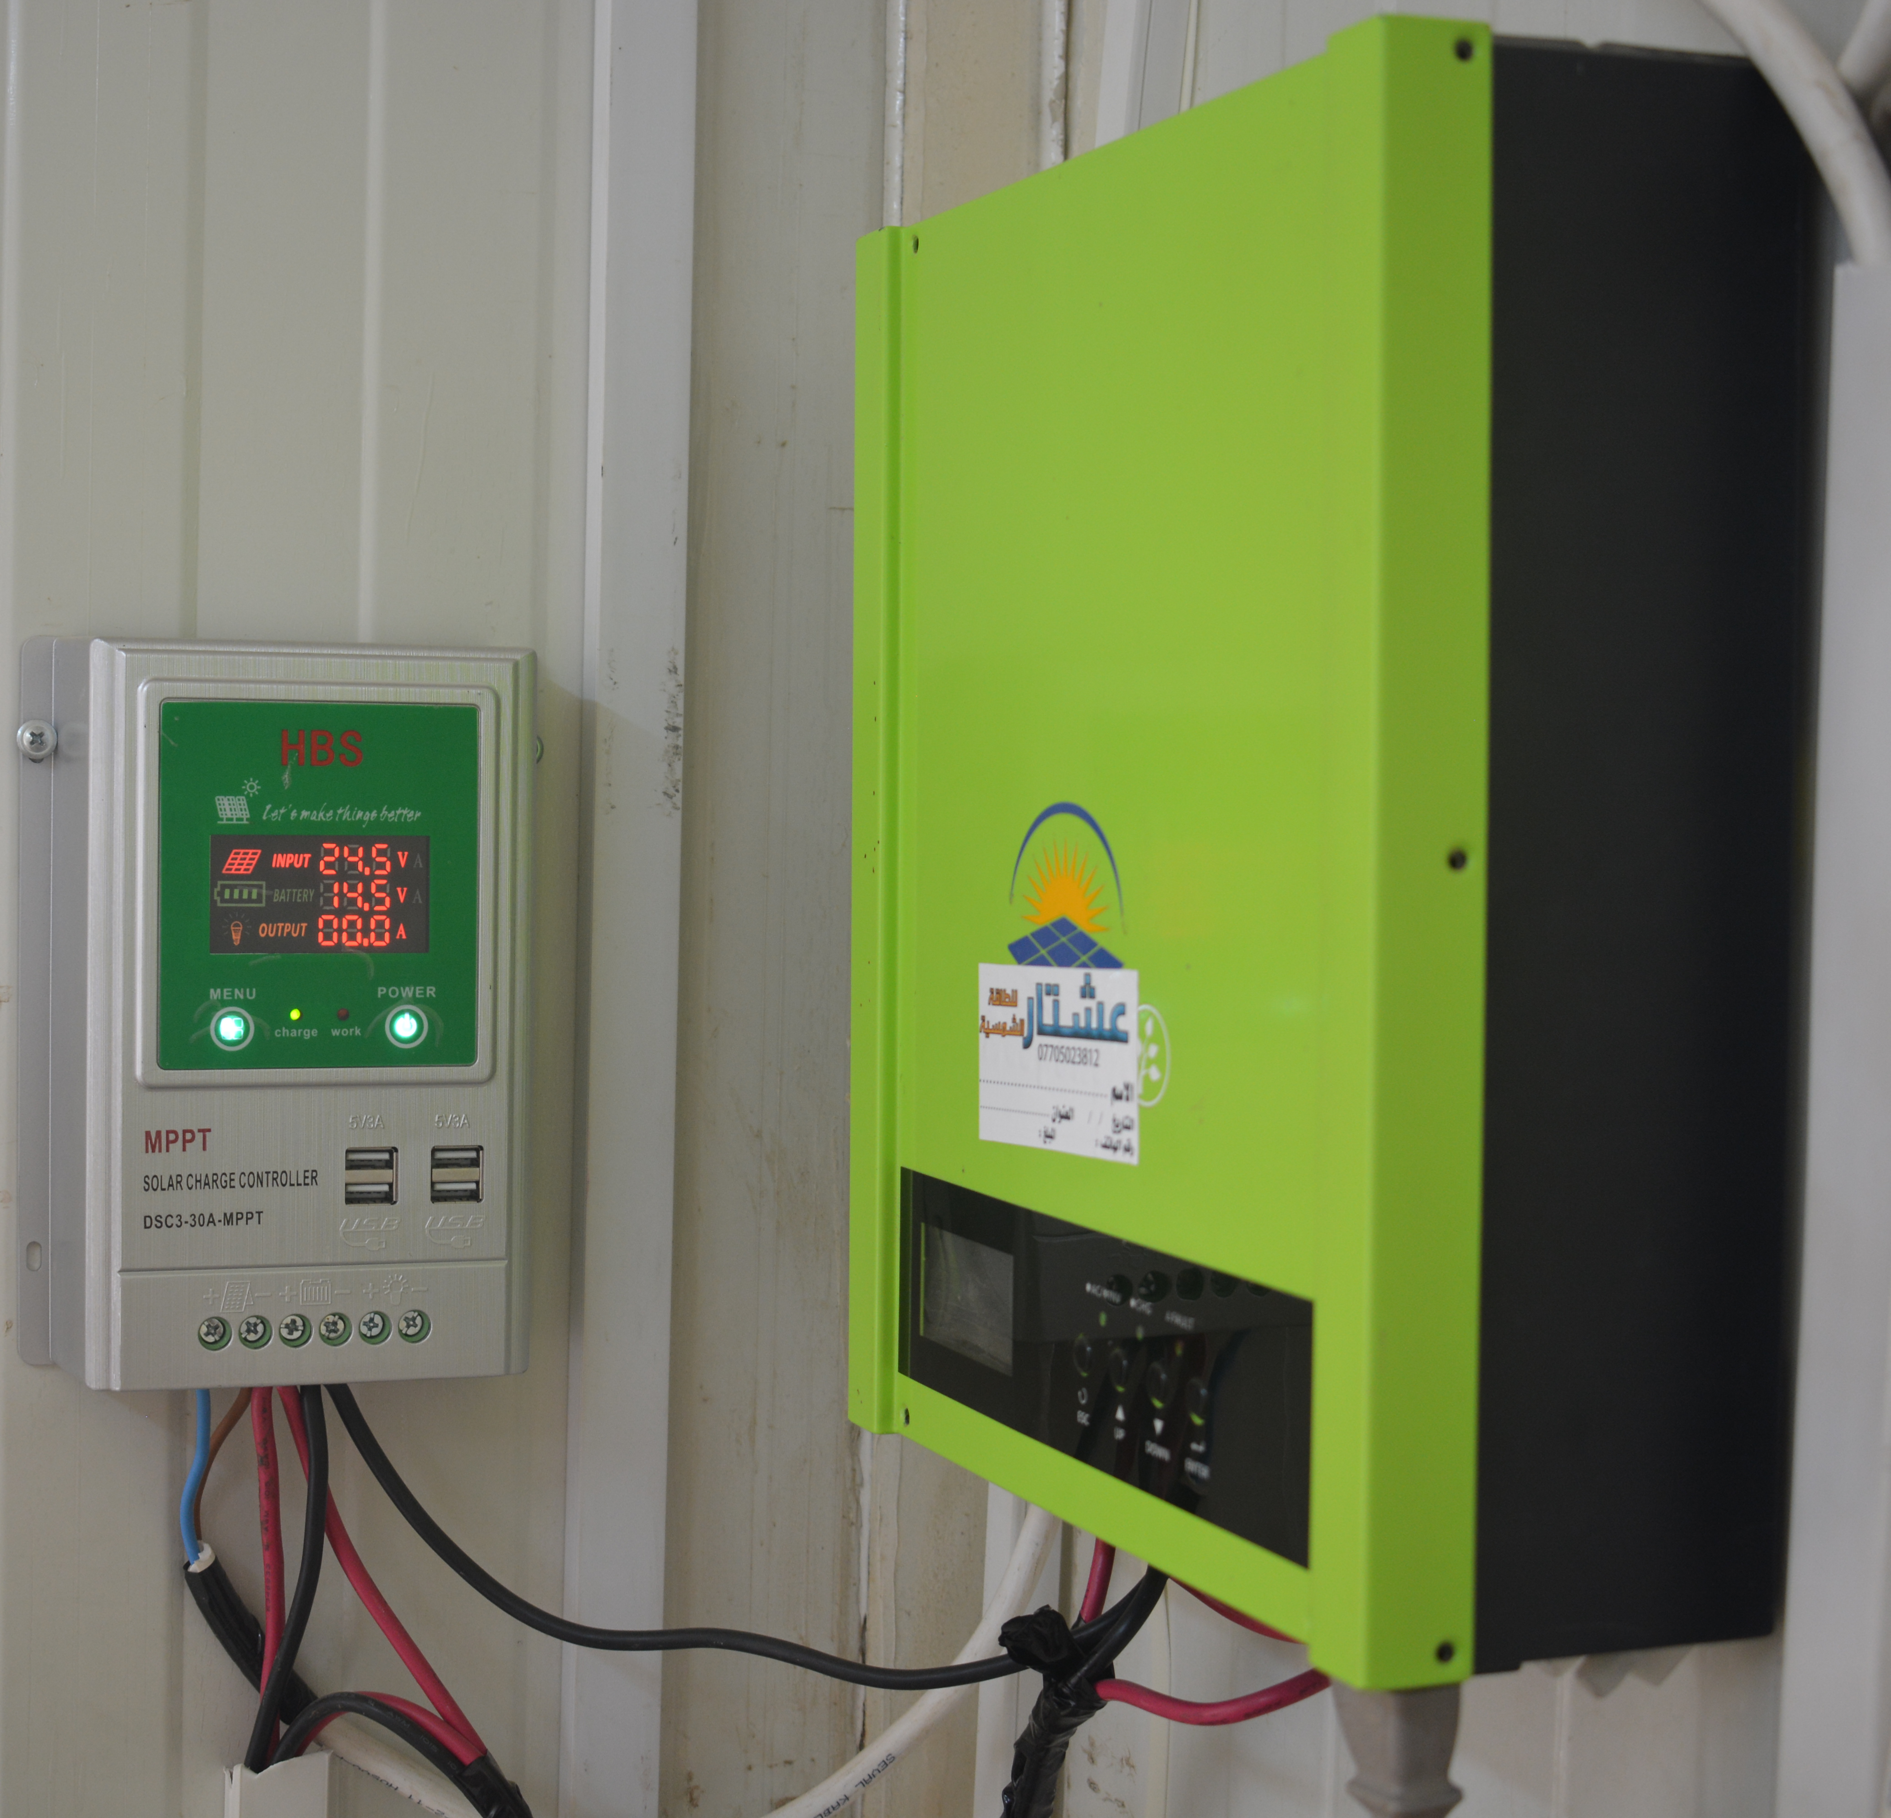
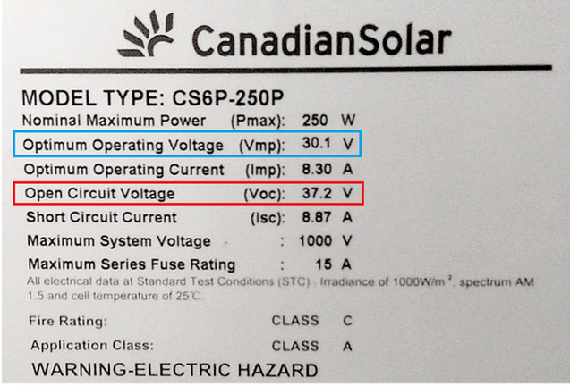
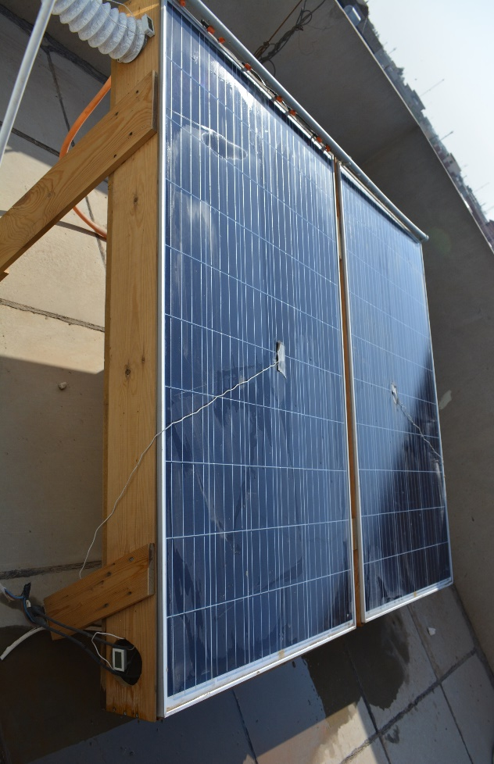
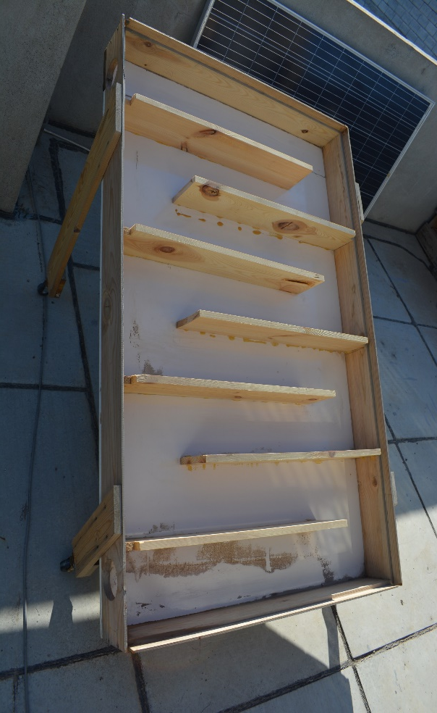
Solar system(SS)
Invertor
Properties of PV Panel
PV Panel
Wood Frame

Slide 19
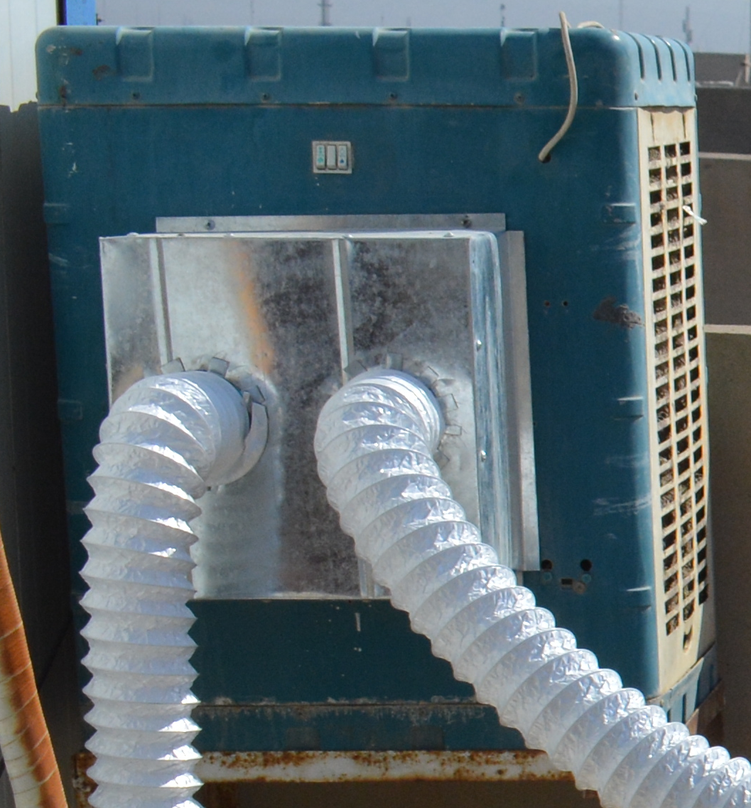
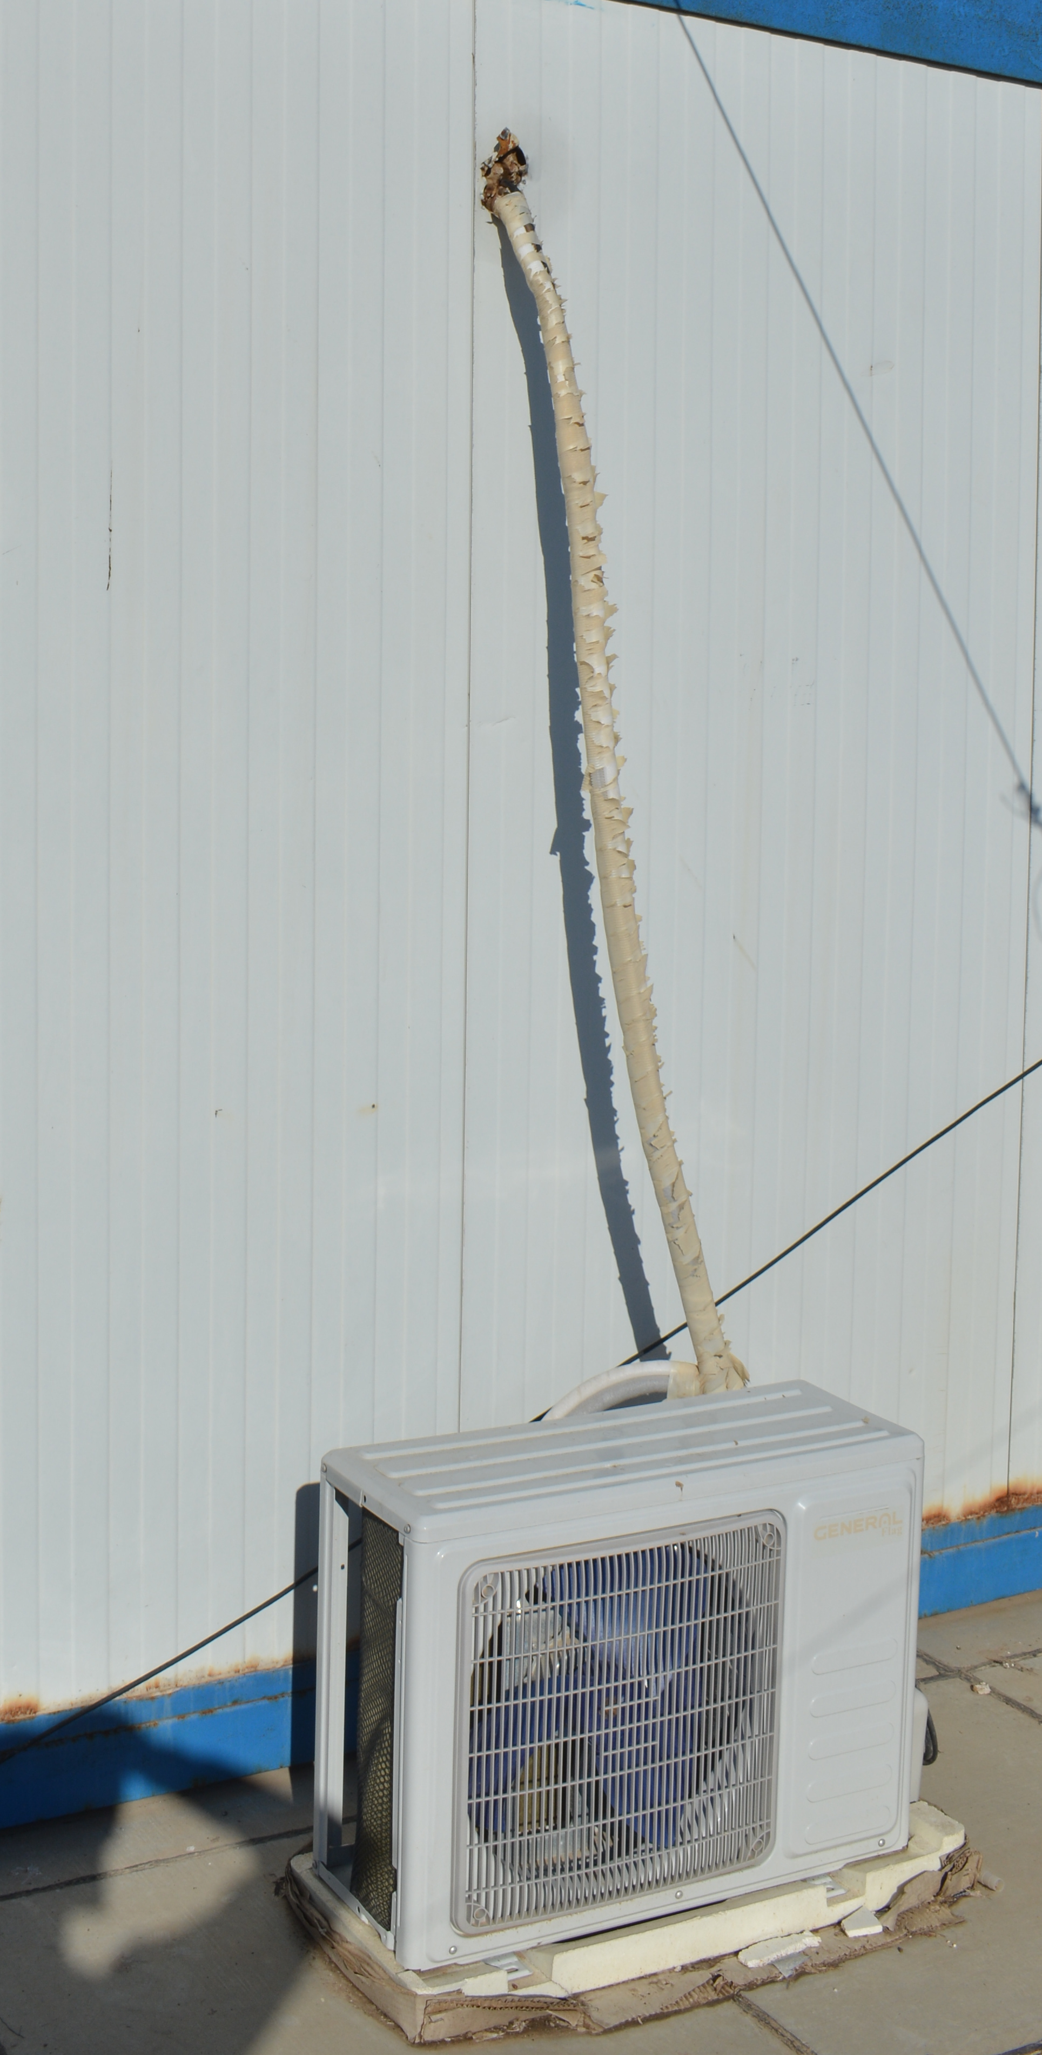
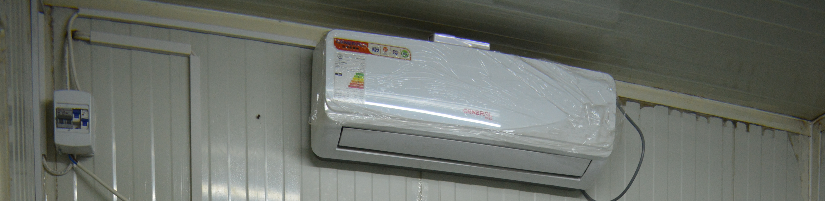
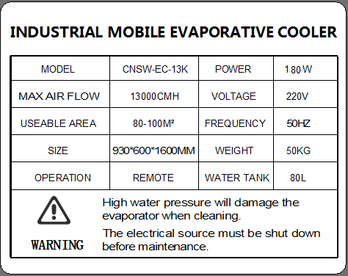
Air-Condition Unit(A/C) & Evaporator Air- Cooler(EAC)
Brand | Midea, made in P.R.C
(Cooling – Heating) Capacity | (12500 – 13000) Btu/hr
Operating Pressure Limits (Discharge – Section) | (3-1) Mpa
Refrigerant, Mass | R-22, 0.83 kg
Power Source | 220-240V~ - 50Hz, 1Ph
Cooling Rating (Current – Power) | 5.6A – 1290W
Heating Rating (Current – Power) | 5.1A – 1175W
Maximum Rating (Current – Power) | 10A – 2000W

Slide 20
Different Testes Cases .
Without Using Phase Change Materials.
Cooled the test room by A/C with effect of thermal extraction from floor by cold water resulted from evaporative cooling while A/C's condenser is cooled by waste cold air resulted from evaporative cooling.
Cooled the test room by A/C with effect of thermal extraction from roof by cold water resulted from evaporative cooling while A/C outdoor unit is not cooled by air.
Is the test room cooled by A/C, neither floor nor A/C outdoor cooling.
Test 1
Test 2
Test 3

Slide 21
Different Testes Cases .
WithUsing Phase Change Materials.
Waste air resulted from evaporative cooling won't cool the PV panels.
Waste air resulted from evaporative cooling will cool the PV panels.
Test 4
Test 5

Slide 22

Thank you for your listening

