Slide 1
Effect of Air bubble injection on the performance of a vertical and horizontal double tube heat exchanger
Preparation by: Roasi Abd El Raheem
Supervisor : Assist. Prof. Dr. Ayser Muneer

Slide 2
BACKGROUND
Heat exchanger is a system used to transfer heat between two or more fluids. Heat exchanger used in cooling and heating process. There are common types of heat exchanger such as:
Heat Exchanger Types
Double Tube Heat Exchanger
Helical Tubes
Shell and Tubes Heat Exchanger

Slide 3
APPLICATION OF DOUBLE TUBE HEAT EXCHANGER
Double pipe heat exchanger are used in many industries because of there low design and maintains costs ,flexibility ,and low installation costs. double pipe heat exchanger can be categorized based on the flow direction parallel flow and counter flow. The application of double pipe are a lot and it is hard to encompass all a few of them as below :
Boilers and compressors as they have high temperatures and pressures
Cooling and heating in prosses engineering systems
Refrigeration
Petroleum refining

Slide 4
Technique Used In This Research
Air injection as an active heat transfer enhancement plays an important role for enhancement heat transfer in engineering application.
The purpose of using air bubbles as active technique is that when air bubbles are about to be created, they are starting in vertical motion inside the liquid due to the effect of buoyancy force. The air bubbles action will raise the level of turbulence destroying the boundary layers accompanied to the fluid flow. Consequently, vertical movement and mobility of the bubbles can be utilized as an efficient method to improve the thermal parameters of the heat exchangers (Moosavi et al., 2016).

Slide 5
Scope of Present Work
calculate
overall heat transfer
Pressure drop ΔP
Effectiveness
Number of heat transfer Units
Experimental
Numerical
Compare experimental work with numerical simulation to verify the results

Slide 6
NUMERICAL SOULUTION
The problem of heat transfer enhancement by air bubbles injection into heat exchanger is mathematically analyzed for Double tube heat exchanger. The continuity equation, momentum equations and energy equation are simplified and rewritten in cylindrical coordinate system for two cases with air injection and without air injection.
Numerical model is solved by using a CFD fluid CFX (Ansys21 R1).At first draw a geometry two pipe for both cold fluid and hot fluid were designed with building mesh and setting up the materials , cell zone conditions , mesh interfaces and boundary conditions to initialize the solutions and run the calculations to get the results

Slide 7
Boundary condition
For numerical part, the temperature of inlet of hot and cold water are set at (333K,60C˚)and (290K,17C˚)respectively.
The hot and cold water flow rate are varied between (3-5)lpm with (0.5)lpm step.
Air bubbles were injected into cold water with flow rates (0.5-2)lpm, with (0.5)lpm steps.
Three dimensions model is used

Slide 8
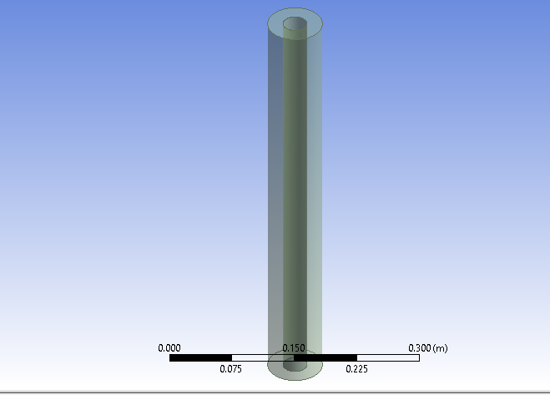

Slide 9
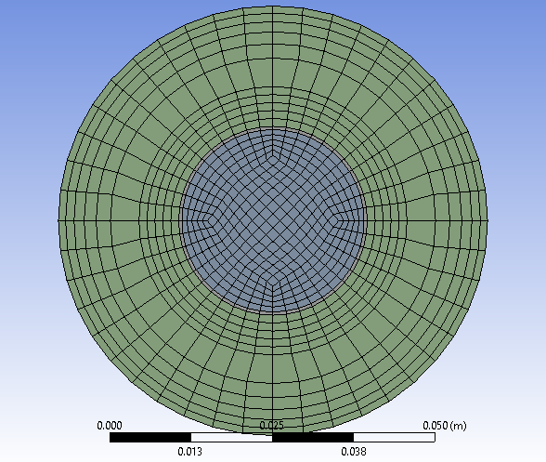
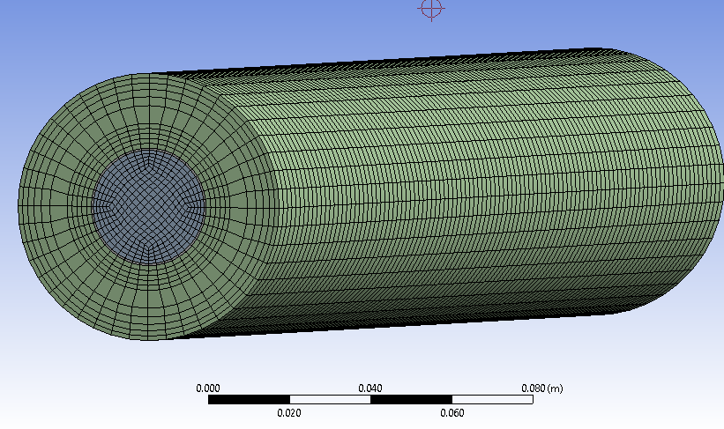

Slide 10
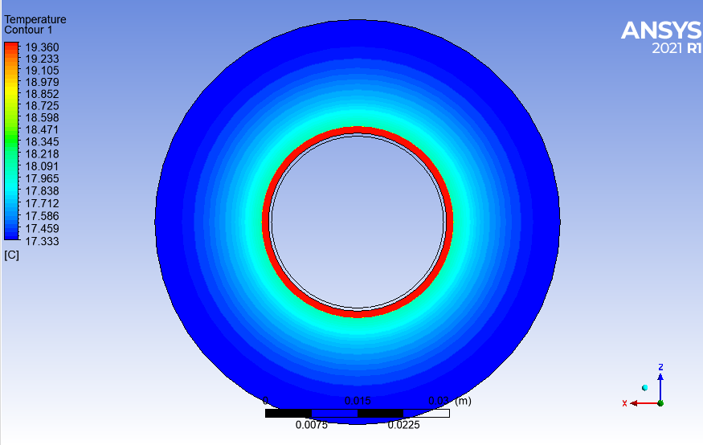
NUMERICAL RESULTS
Static temperature contour

Slide 11
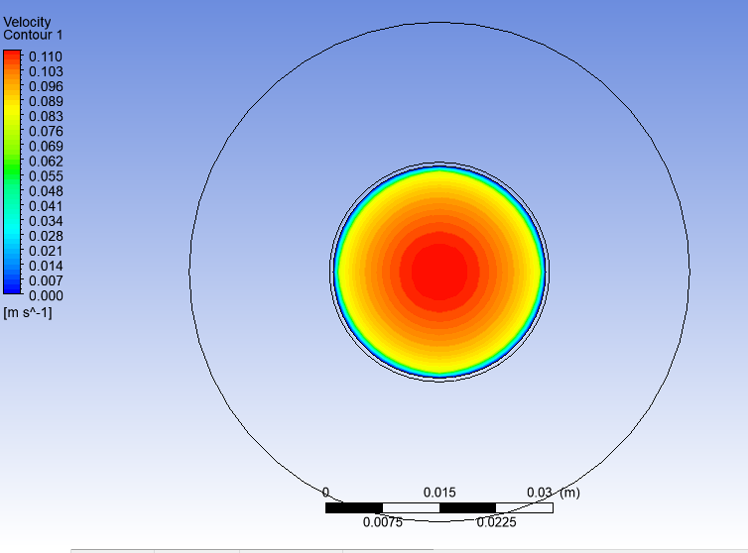
Velocity magnitude contour

Slide 12
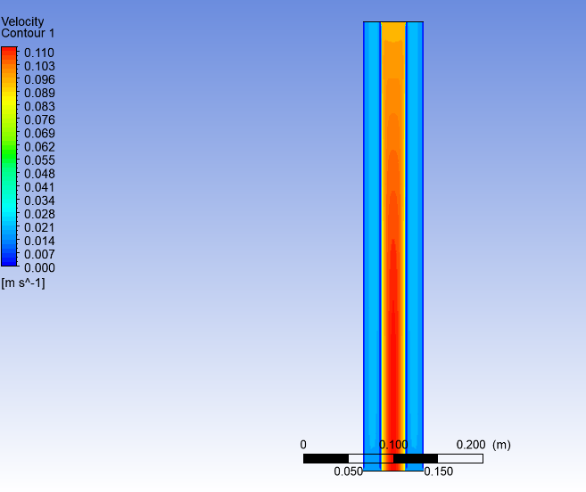

Slide 13
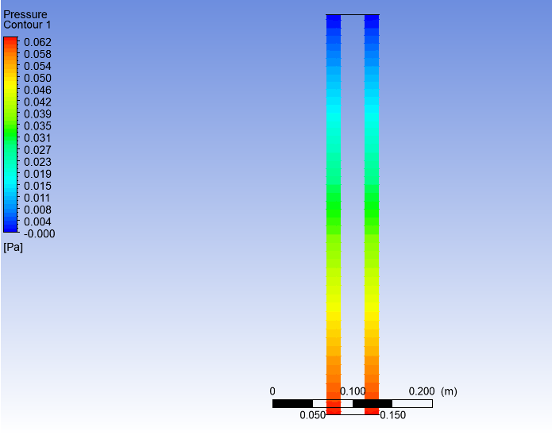
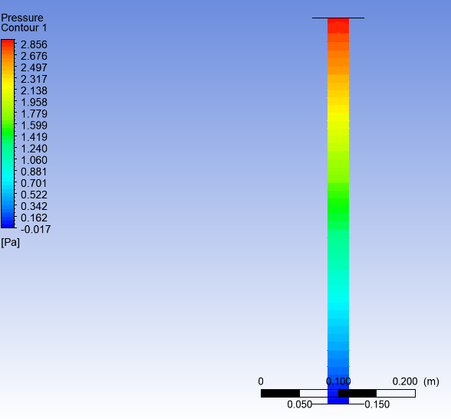
Pressure contours

Slide 14
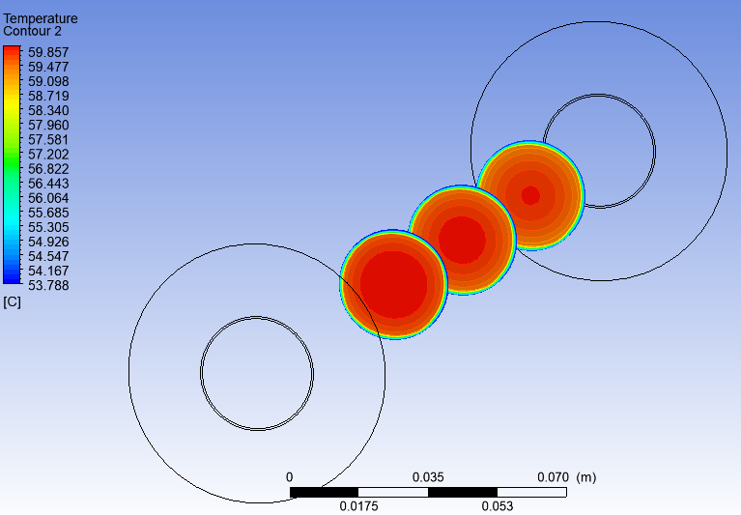

Slide 15
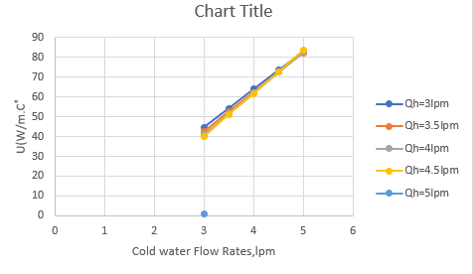
OVERALL HEAT TRANSFER Coefficient

Slide 16
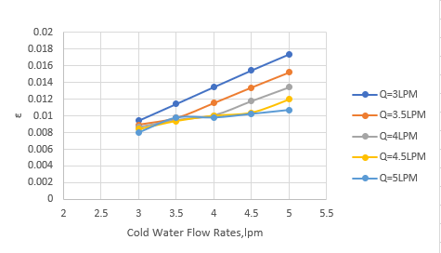
Effectiveness ,ɛ

Slide 17
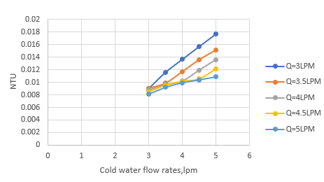
NUMBER OF HEAT TRANSFER UNIT,NTU

Slide 18

EXPERIMENTAL WORK
The main parts of experimental rig, generally can be divided into three main units, which briefly described as follows:
Aquarium air compressor with(1.5bar)pressure used to supply fresh air into the plastic tubes .The flow configuration of the system was counter flow. Polyolefin foam insulation sheet with very low thermal conductivity (0.002$w/{m.k}$ )

Slide 19
Heating Units
Hot water tank
Variac
Cooling Units
Cold water tank
Heat exchange unit
PVC shell
Rotary compressor
Evaporator
Condenser
Expansion valve
Copper tube
Plastic tube with different number of holes installed in the bottom of shell side
Electrical heater

Slide 20
Tube | Outer diameter (mm) | Inner diameter (mm) | Material | Length (mm)
Cold water tube | 68 | 66 | Perspex PVC | 500
Hot water tube | 29 | 28 | Copper alloy | 525

Slide 21
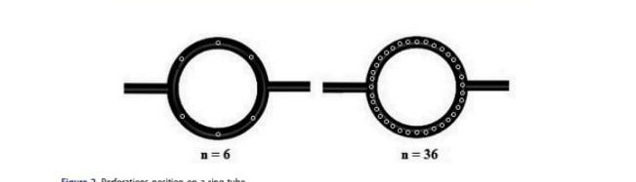
Air injection Technique
In this research we use three plastic pipe with different number of holes and distance from the copper pipe
One with 36 holes ,second with 24 holes and finally one with 12 holes

Slide 22
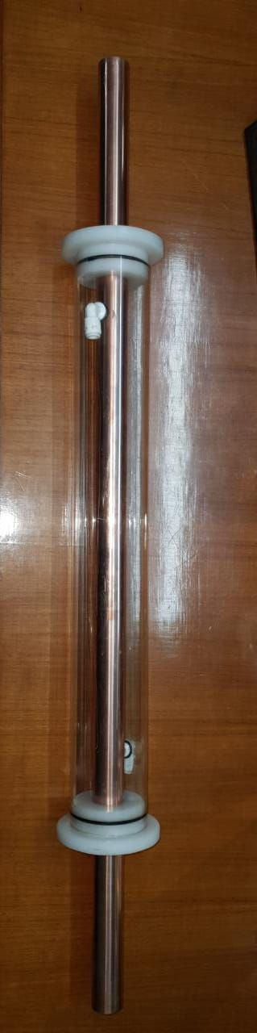

Slide 23
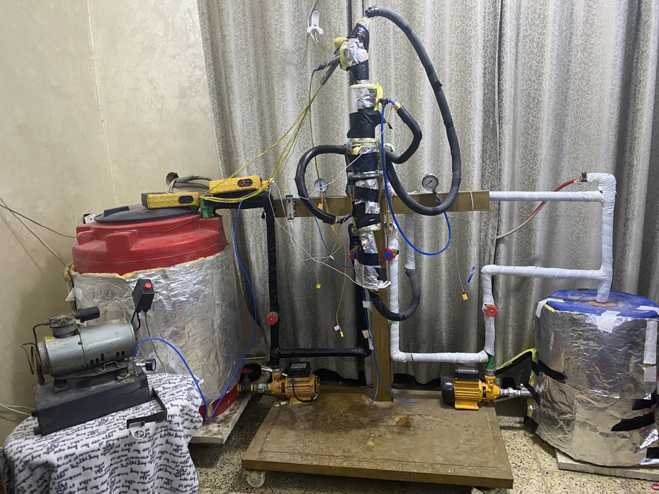

Slide 24
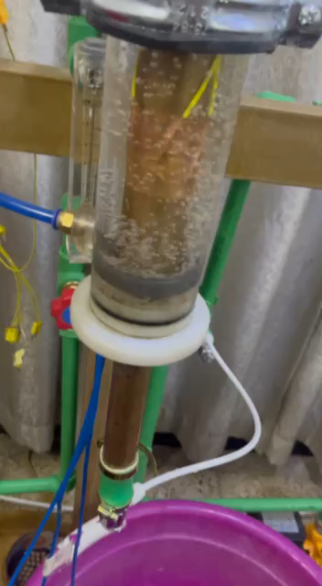

Slide 26
Thanks for listening

