Slide 1
How to Improve your Academic Writing
Presented by
Asst. Instructor.Hiba Kareem Neamah

Slide 2
What is Academic Writing?
Academic writing is a type of writing which communicates ideas, information and research to the wider academic community. It can be divided into two types: student academic writing, which is used as a form of assessment at university, as well as at schools as preparation for university study; and expert academic writing, which is writing that is intended for publication in an academic journal or book.

Slide 3
The importance of academic Writing
Academic writing is a form of language used by people who communicate within an academic context using a written means. such context is formal in terms of relationships, thinking, performance, creativity, competitions among peers.
Language is a social construct that is created by the people who use it and influenced by the context in which it is used.
Do you use the same language at home, at a professional meeting, or at a pub? In fact it may be considered inappropriate, therefore language must change when language do.
When interacting in academic context , you should use the language associated to it.

Slide 4
The importance of academic Writing
Why is academic writing important?
Academic writing is a means of producing, codifying, transmitting, evaluating, renovating, teaching, and learning knowledge and ideology in academic disciplines. Being able to write in an academic style is essential to disciplinary learning and critical for academic success

Slide 5
Why is academic writing important?
Academic writing is a means of producing, codifying, transmitting, evaluating, renovating, teaching, and learning knowledge and ideology in academic disciplines. Being able to write in an academic style is essential to disciplinary learning and critical for academic success

Slide 6
The Characteristics of Academic Writing
Formal
Explicit
Precise
Structured

Slide 7
Writing a formal essay
Academic writing is formal in terms of the vocabulary used. It means that colloquial expressions, abbreviated forms of verbs, idioms, and emotional language should be avoided.
Don’t use verb contractions like we’ll (we will), he’d (he would)
Don’t starts your writing with numerals- write numbers as full words to start with. 3 methods are used instead we say: Three methods are used
Don’t use exclamation marks and question marks unless you quoting something.
Avoid contractions, form your possessives in the form ‘of the’ :
“The teenagers of today” instead of “today’s teenagers”

Slide 8
Writing a Formal essay
Don’t use “Okay” “acceptable” or “Satisfactory”
Use sophisticated transitions “in addition”, “besides”, “consequently”,
moreover “and”, “but”, “or”
Avoid using dialogue in a formal writing:
The Kid told me ”Iam happy with my new school”.
The kid told me that he was happy with his new school.
List things properly by using “and” between the last two items:
We used three methods: A,B,C We used three methods: A, and B, and C
We used three methods: A, B, and C.

Slide 9
Formal Vocabularies
Avoid words or phrases used mainly in normal conversation as they’re usually not suitable for use in academic writing. Dictionaries often identify these words with the label “informal.” In your essay, use a more formal equivalent. Here are some examples:
Avoid “kids”, use “children”,
Avoid “a lot of”, use “much, many”
Never use colloquial English or slang. Colloquial English is a type of informal English, and it includes words such as gonna or wanna, and phrases such as ain’t nothin’ and dead as a doornail.
Avoid abbreviating words in academic writing: can’t , shouldn’t, won’t

Slide 10
Explicit Academic writing
Academic writing has to be precise and accurate which means there should be no ambiguity. In order to be precise, do the following:
-Use simple sentence structures (He likes to paint by himself)
Although he is not a painter, but he likes to paint by himself.
Use active voice (don’t hide the performer).
Anna painted the house (active)
The house was painted skillfully (passive)
-Include linking words:
- He took a large umbrella so that if it rained, he wouldn’t get wet

Slide 11
Avoid garden-path sentences:Garden-path sentences lead the reader down an (interpretation) path with a dead end: these sentences are grammatically correct, yet when read for the first time, they leave the reader confused and in need to read the sentence again to understand it.
An example: “The old man the boat” The confusion happens because we interpret every word as we read it, not waiting until the end where the sentence structure would have revealed itself.
Man (as a noun) first reading
Man= to staff/fill the boat. (as a verb) second and final reading.

Slide 12
Precise Academic Writing
It’s important to use clear and precise language to ensure that your reader knows exactly what you mean. This means being as specific as possible and avoiding vague language.
For example: People have been interested in this thing for a long time.
Researchers have been interested in this phenomenon for at least 10 years

Slide 13
structured Academic Writing
Essay , and study reports have specific structures. That fact assures that information is presented in a logical way and that idea can be developed clearly and function as a unit

Slide 14
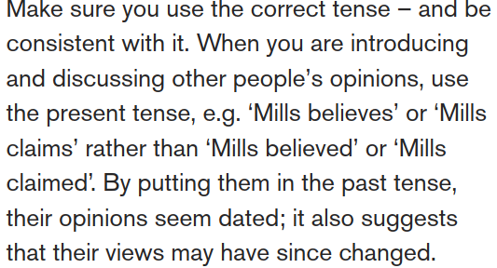
Grammar and Punctuation
Avoid inappropriate use of tense

Slide 16
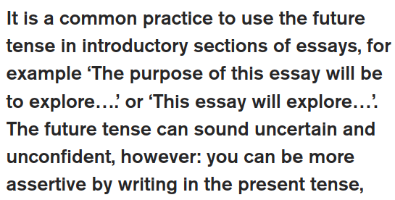

Slide 17
Incorrect use of prepositions
What are prepositions?

Slide 18
An Example
Student example: we have disconnected with our fellow members of society and no longer know the neighbours around us. There are so many of us now that we seem to of lost a sense of community and become strangers on our society.
Disconnected with (together)
Disconnected from.
We seem to of lost.
We seem to have lost .
Become strangers on our society.
Become strangers on our society

Slide 19
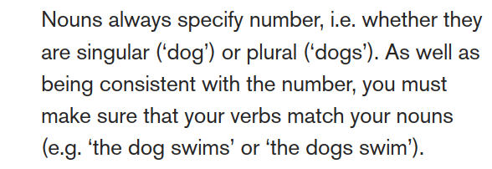
Confusing singular and plural

Slide 20
Using inappropriate words
Student example:
‘ Basically, the policy aims to improve the quality of the service…..’
The word ‘basically’ is inappropriate in academic writing
why
Because the purpose is not to reduce things into their most basic form, but to explore issues and ideas in their full complexity.
Basically instead ‘in essence’ , ‘to summarize’, or ‘in short'

Slide 21
Thank you

