Slide 1
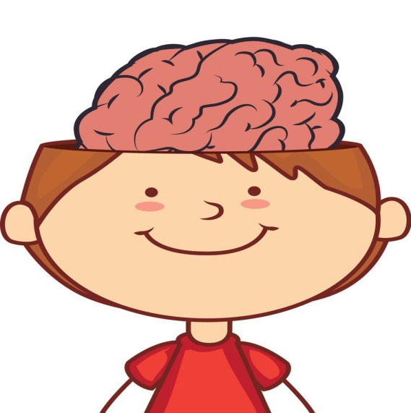
Identifying College Students’ Multiple Intelligences to Enhance Motivation and Language Proficiency
:Lectured by
Asst. Prof. Bushra Nimaa (PHD)

Slide 2
Introduction
In this work shop basic exercizes and techniques are used in order to provid language teachers with new instructional designs to put the theory of multiple intelligences into practice.
multiple intelligences: are multiple mental abilities in human beings. These multiple abilities are a combination of biological and cultural domains.

Slide 3
Multiple intelligences (MI) theory has attracted much attention in the field of education as a useful framework for educators and curricula all over the world. Although Howard Gardner, the pioneer of this theory, did not intend to create the theory for education instruction, it became popular in educational practice as it caters for studentsu2019 diverse profiles, through providing multi-way learning tools and assessment opportunities. Various studies connected MI and education, such as multiple intelligences in the classroom (Armstrong, 2009), teaching and learning through multiple intelligences (Campbell et al., 1996) and multiple intelligences-based instructions (Yaumi, 2013).

Slide 4
FOOD FOR THOUGHT

Slide 5
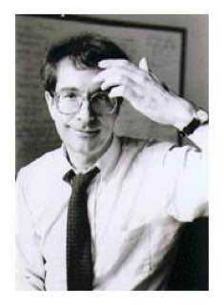
Dr. Howard Gardener
Howard Earl Gardner is an American developmental psychologist and research Professor of Cognition and Education at the Harvard Graduate School of Education.
He is best known for his theory of Multiple Intelligences.

Slide 6
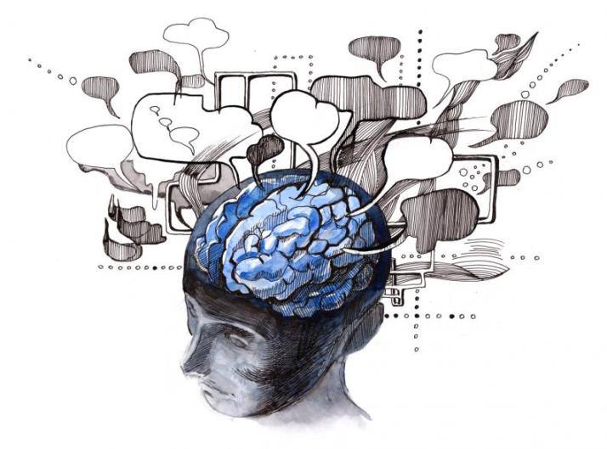
According to Howard Gardner, human beings exhibit multiple intelligences. Human intelligences can be classified into eight core forms of intelligences. Based on the specific abilities that human beings possess,their intelligence can be categorized under one of those core forms of intelligences.

Slide 8
MI & SKILLES
Linguistic intelligence-Skilled with words
Bodily/kinesthetic intelligence-physical skill
Musical intelligence: skilled with melody and rhythm
Spatial intelligence: skilled with pictures and images
Interpersonal intelligence: skills of social understanding
Intrapersonal intelligence: skills of self-knowledge
Logical/mathematical intelligence: skilled with numbers & reasoning
Naturalistic intelligence: skills of making connection with elements in nature

Slide 9
LINGUISTIC INTELLIGENCE
Linguistic Intelligence is the capacity to use a foreign language, your native language, and perhaps other languages, to express what's on your mind and to understand other people. Usually found in poets, copywriters, novelists, journalists, scriptwriters, orators, seminar presenters, politicians, editors, publicists, journalists, speech writers, lawyers.

Slide 10
LINGUISTIC INTELLIGENCE-TRAITS
Like to read, write and listen
Good at spelling
Sensitive to patterns
Like word games Good memory for general knowledge
Orderly and systematic
Ability to reason Good public speaker/debater though may prefer either oral or written communication

Slide 11
Verbal Linguistic students are known to be Word Smart. Normally, these types of students are good at reading, writing, speaking, telling stories, have a good vocabulary, and like to play with words. Students who have a verbal / linguistic intelligence think in words, write clearly, spell easily, have a good vocabulary, and communicate effectively with others.

Slide 12
Exercises can be undertaken at home and at university to strengthen verbal linguistic intelligence. Some of them can be:
Reading, Writing, Narrating - Stories, Sequels, Poems, Drama, Jokes, Descriptions, News Reports
Encouraging - Debates, Declamations, Impromptu Speech (on current affairs, life, practically everything)
Starting - a Newsletter, Magazine, Journal
Conducting - Mock Interviews, Chat Shows, Role Plays, Dramas, Story Telling
Solve - Puzzles, Crosswords, Vocabulary Games
Preparing and Giving Presentations
Creating Slogans, Defense, Case Studies etc
Initiating Vocabulary Banks

Slide 13
ACTIVITIES - STRENGTHEN LINGUISTIC INTELLIGENCE (HIGHER STAGES)
Have debates about current events
Discuss life, the universe and interesting experiences!
Read different kinds of novels, stories and jokes
Write stories and jokes write letters/emails to pen-pals
Write book reviews and product reviews Make advertisements on the given product
Keep a journal, write poems
Interview friends, family and mentors
Do puzzles and crosswords

Slide 14
Debate about current events

Slide 15
Reading stories

Slide 16
How to write a review of book , product, etc.
Comprehensive components of writing a review:
1.1. Start with a couple of sentences describing what the book is about
But without giving any spoilers or revealing plot twists! As a general rule, try to avoid writing in detail about anything that happens from about the middle of the book onwards. If the book is part of a series, it can be useful to mention this, and whether you think you'd need to have read other books in the series to enjoy this one.
2. Discuss what you particularly liked about the book
Focus on your thoughts and feelings about the story and the way it was told. You could try answering a couple of the following questions:
Who was your favourite character, and why?
Did the characters feel real to you?
Did the story keep you guessing?
What was your favourite part of the book, and why?
Were certain types of scene written particularly well - for example sad scenes, tense scenes, mysterious ones...?
Did the book make you laugh or cry?
Did the story grip you and keep you turning the pages?
3. Mention anything you disliked about the book
Talk about why you think it didn't work for you. For example Did you wish the ending hadn't been a cliffhanger because you found it frustrating?Did you find it difficult to care about a main character, and could you work out why?Was the story too scary for your liking, or did it focus on a theme you didn't find interesting?
4. Round up your review
Summarise some of your thoughts on the book by suggesting the type of reader you'd recommend the book to. For example: younger readers, older readers, fans of relationship drama/mystery stories/comedy. Are there any books or series you would compare it to?
5. You can give the book a rating, for example a mark out of five or ten, if you like!
Luisa Plaja loves words and books, and she used to edit the book review site Chicklish. Her novels for teenagers include Split by a Kiss, Swapped by a Kiss and Kiss Date Love Hate. She lives in Devon, England, and has two young children.

Slide 17
Lyndsey reviews George Orwell’s 1984 on Goodreads:
YOU. ARE. THE. DEAD. Oh my God. I got the chills so many times toward the end of this book. It completely blew my mind. It managed to surpass my high expectations AND be nothing at all like I expected. Or in Newspeak "Double Plus Good." Let me preface this with an apology. If I sound stunningly inarticulate at times in this review, I can't help it. My mind is completely fried.
This book is like the dystopian Lord of the Rings, with its richly developed culture and economics, not to mention a fully developed language called Newspeak, or rather more of the anti-language, whose purpose is to limit speech and understanding instead of to enhance and expand it. The world-building is so fully fleshed out and spine-tinglingly terrifying that it's almost as if George travelled to such a place, escaped from it, and then just wrote it all down.
I read Fahrenheit 451 over ten years ago in my early teens. At the time, I remember really wanting to read 1984, although I never managed to get my hands on it. I'm almost glad I didn't. Though I would not have admitted it at the time, it would have gone over my head. Or at the very least, I wouldn't have been able to appreciate it fully. […]

Slide 18
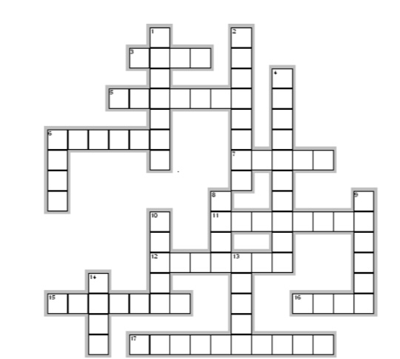
Crossword - ARTS & MEDIA
Across.
3. A group of musicians who play modern music together.
5. The collective term for music, art, theatre, literature, etc.
6. A large, printed picture or notice put on a wall, in order to decorate a place or to advertise something.
7. Several songs or pieces of music on a CD, a record, etc.
11.The people who sit and watch a performance at a cinema, theatre, etc.
12. book, newspaper, etc. that is one of several that are the same and were produced at the same time.
15. A television or radio station (= broadcasting company).
16.Atelevision or radio programme or performance.
17. A very popular book that many people have bought.
Down
1. A room or building which is used for showing works of art.
2. A short period of time between the parts of a play, performance, etc.
4.When objects such as paintings are shown to the public.
6. The story of a book, film, play, etc.
8. A person in a play or a film.
9. A report in a newspaper, magazine or programme that gives an opinion about a new book, film, etc. (6)
10. A view or picture of a film, play or show.
13. A picture, especially on film or television or on a screen.
14. All the actors in a film, a play or a show.

Slide 19
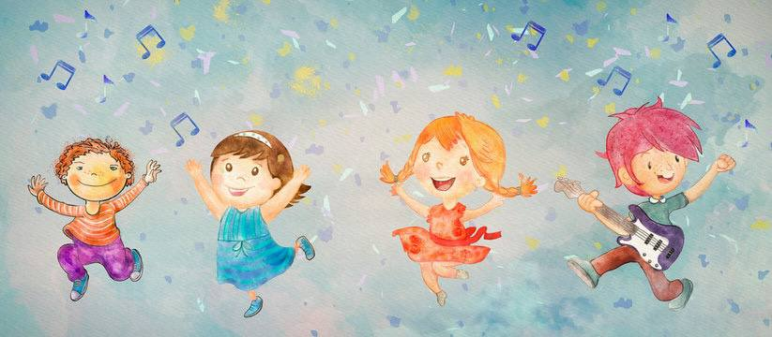
MI BASED ACTIVITIES IN LANGUAGES
Compositions ‘
Set tunes to poems & sing them in the classes
Dramatization of the lessons
Role Play Picture composition

Slide 20
LOGICAL/MATHEMATICAL INTELLIGENCE-TRAITS
Math smart Enjoy working with numbers
• Easily interpret data and analyze abstract patterns
• Demonstrate a well-developed ability to reason
• Good at chess and computer programming
• Think in terms of cause and effect

Slide 21
VISUAL/SPATIAL INTELLIGENCE TRAITS
Picture Smart
Think and process information in pictures and images
Have excellent visual receptive skills and excellent fine motor skills
Use their eyes and hands to make artistic or creatively designed projects
Read maps, and put together multiple numbers of pieces of jigsaw puzzles with ease

Slide 22
BODILY-KINESTHETIC INTELLIGENCE TRAITS
Highly developed coordination, balance, dexterity, strength, speed, and flexibility
Expertise in using the entire body to relate thoughts and feelings
An ability to manipulate objects skillfully, using both fine and gross motor movements
Examples: Dancers, football players ,etc.

Slide 23
MUSICAL/RHYTHMIC INTELLIGENCE TRAITS
Music Smart
Think, feel, and process information primarily through sound
Have a superior ability to perceive, compose, and/or perform music
Constantly hear musical notes in their head.

Slide 25
NATURALISTIC INTELLIGENCE TRAITS
Nature Smart Enjoy being in nature and want to protect it from pollution
Easily recognize and categorize plants, animals, and rocks
Connect with nature and the elements of nature

